Slide 1

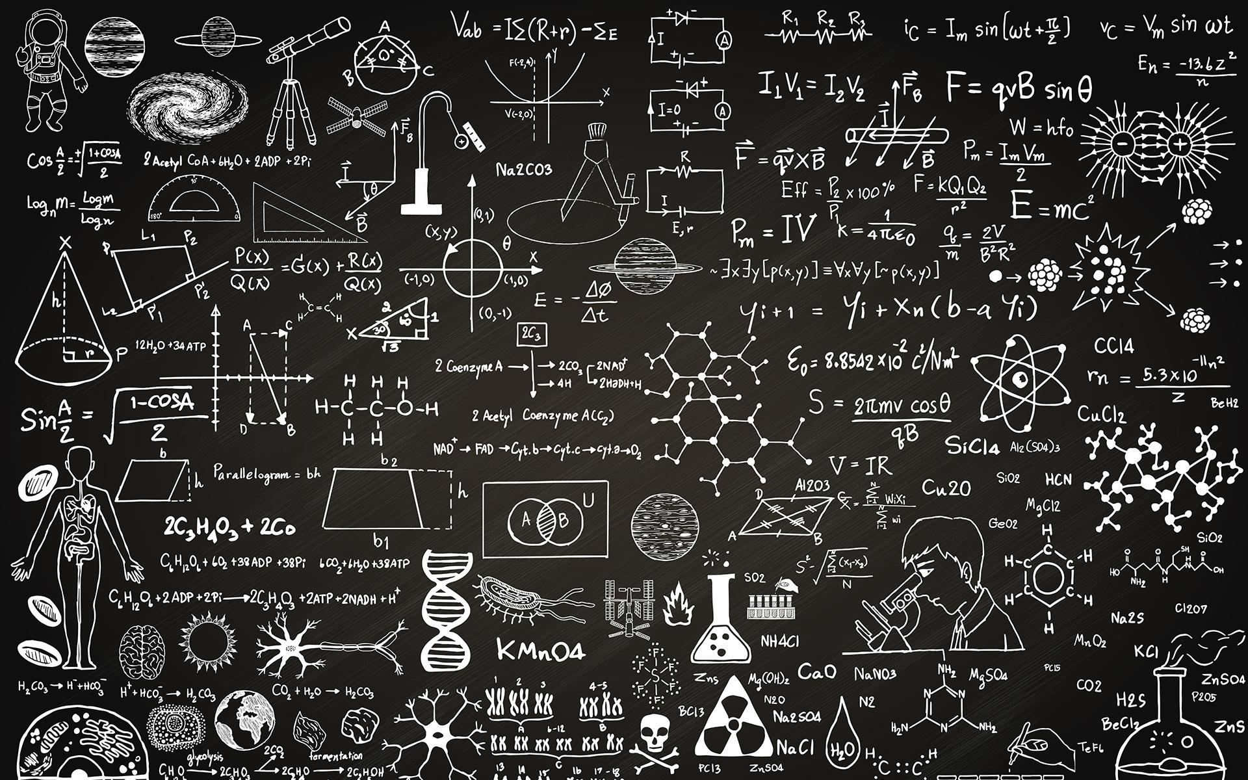

Time Series
Christa Santos

Slide 2








ABOUT ME
Christa Santos - Data Scientist
Formación Académica
Experiencia Profesional
2019 - Present | Online courses on various platforms: Datacamp, Coursera, Udemy…
2015 – 2016 | Master in Business Analytics and Big Data Instituto de Empresa
2008 – 2012 | Bachelors in Electronics y Communication VIT University
2019 – Present | Data Science Lecturer Nuclio Digital School
2019 – Present | Delivery Data Scientist Microsoft
2016 – 2019 | Senior Data Science Consultant Ernst & Young
Contact Details
christabelle@alumni.ie.edu
Christa Santos

Slide 3
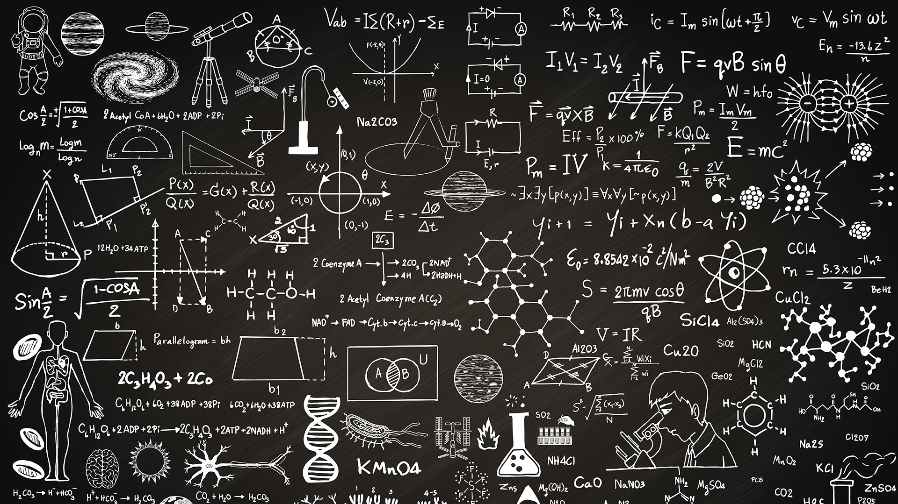

MACHINE LEARNING LANDSCAPE
00

Slide 4


MASTER DATA SCIENCE
CHECKPOINT
MACHINE LEARNING TASKS
TIME SERIES
"Estimate the sales of a store for the next 12 months"

Slide 5
SERIES TEMPORALES
INTRODUCTION: PLANNING
SESIÓN 1
SESIÓN 2
SESIÓN 3
SESIÓN 4
BLOCK I (1h 25 min)
Introduction
Time Series: ARIMA Modeling
Time series: Prophet
Time Series: Boosting Prediction & Interpretation
Introduction to Temporal Data
Data and Dates
BREAK - 10 MIN
BLOCK II (1h 25 min)
Introduction to Time Series
Time Series:
Hands on - ARIMA
Time Series:
Hands on - Prophet
Time Series: Hands On

Slide 6
TIME IN PYTHON
01

Slide 7
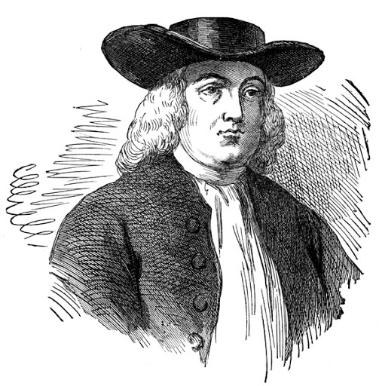

INTRO TO TIME DATA
INTRODUCTION: TIME IN DATA SCIENCE
‘Time is what we want the most and what we use the worst’
William Penn

Slide 8

INTRO TO TIME DATA
INTRODUCTION: TIME IN DATA SCIENCE
Time is a key aspect of data science. Time series prediction is an obvious application of time use, but also other algorithms and models consider information related to time variables (age, events) to achieve the results. And not only that, but some tools also need to be applied in real time or used in different time zones.
Time is a numerical variable, number of seconds with respect to a given time, although the formats represent it in a similar way to the 'human' calendar.
The library for most used in Python for time data is datetime and allows us to operate with temporal data.
tomorrow > today > yesterday

Slide 9
INTRO TO TIME DATA
INTRODUCTION: DATA TYPES IN DATETIME
The data types in the datetime package can be:
Type
Description
Example
datetime
Combination of time and hour
2021-05-09 08:23:52.257702
date
Date variable
2021-06-13
time
Time variable
08:23:52.964269
timedelta
Date/Time increment
0:00:01.152072
timezones
Timezone reference
UTC
In addition, general variable types (object string or numeric) can also contain temporal information

Slide 10

INTRO TO TIME DATA
INTRODUCTION: EXAMPLE IN DATETIME
The datetime data class is more the one used and represents a specific instant in time at the microsecond level
2021-05-08 14:45:40.663246
datetime.datetime(2021, 5, 8, 14, 45, 40, 663246)
date
time
year
month
day
hour
minute
second
microseconds

Slide 11
INTRO TO TIME DATA
INTRODUCTION: CREATING TIME VARIABLES
It is important to create datetime variables:
With the type of datetime: We use datetime parameters to create a specific variable
datetime(1950,2,24,12,3,12, 12)
From a chain of text (string): The datetime.strptime function is used with the text string. The formatting can be complex, and it is important to make sure that the format is correct
datetime.strptime(dt_string = "12/11/2018 09:15:32", "%d/%m/%Y %H:%M:%S")
From a timestamp: The timestamp (unix) is the number of seconds since 1970-01-01
dt = datetime.fromtimestamp(1294204471)
With other functions of time: Certain functions allow us to obtain specific dates, such as the time of today or now.
datetime.now()

Slide 12
INTRO TO TIME DATA
INTRODUCTION: DATA FORMAT
Time-related information can be obtained in the following formats:
Symbol | Definition | Example
%a | Weekday name abbreviated | Sun, Mon, Tue, …
%A | Weekday name full | Sunday, Monday,
%b | Month name abbreviated | Jan, Feb, Mar, …
%B | Month name full | January, February, …
%c | A “random” date and time representation. | Fri Jan 15 16:34:00 1999
%d | Day of the month | [ 01, 31 ]
%f | Microsecond | [ 000000, 999999 ]
%H | Hour (24h) | [ 00, 23 ]
%I | Hour (12h) | [ 01, 12 ]
%j | Day of the year | [ 001, 366 ]
%m | Month | [ 01, 12 ]
%M | Minute | [ 00, 59 ]
Symbol | Definition | Example
%p | Locale’s equivalent of either AM or PM. | [ AM, PM ]
%S | Second | [ 00, 61 ]
%U | Week number of the year (Sunday first) | [ 00, 53 ]
%w | Weekday number (Sunday=0) | [ 0, 6 ]
%W | Week number of the year (Monday first) | [0, 53 ]
%x | Locale date | 01/15/99
%X | Local time | 16:34:00
%y | Year without century | [ 00, 99 ]
%Y | Year with century | 1999
%z | UTC offset in the form +HHMM or -HHMM or empty string
%Z | Time zone name or empty string
%% | A literal ‘%’ character.
datetime

Slide 13
INTRO TO TIME DATA
PROCESSING TIME DATA
It is necessary to know some basic processing operations that are very common on a day-to-day basis:
Variable Extraction: Required to create a specific time-related variable
To directly get the any parameter of the time variable
date.year
Using functions: Some variables such as the day of the week may be necessary, but are not included in the datetime attributes
datetime today.weekday()
Variable transformation: The format is flexible, and it can be useful to transform it into another format. The strftime function is used to parse,
datetime = now.strftime("%m/%d/%Y, %H:%M:%S")
Modification of variables: It is not too common, but sometimes it is necessary to modify a field of a datetime type. It is necessary to use the dt.replace
date.replace(day = 1)

Slide 14
INTRO TO TIME DATA
OPERATIONS WITH TIME VARIABLES
Temporal formats also allow certain operations:
Date with Date: The most common operation is the difference of dates, to get the duration of an event, or the period. Some intervals are of special importance such as age (time until today)
age = date.today() - date(1990,1,1)
Date and range: It can be interesting to add or subtract a period from a date, either projecting into the past or into the future.
yesterday = date.today() - timedelta(days=1)
Interval with Interval: Variable with interval allow all kinds of operations between them. They support the same operations as integers.
timedelta(days=1) + timedelta(days=1)
3 * timedelta(days=1)
timedelta(days=1) /3

Slide 15
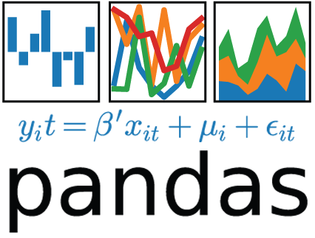
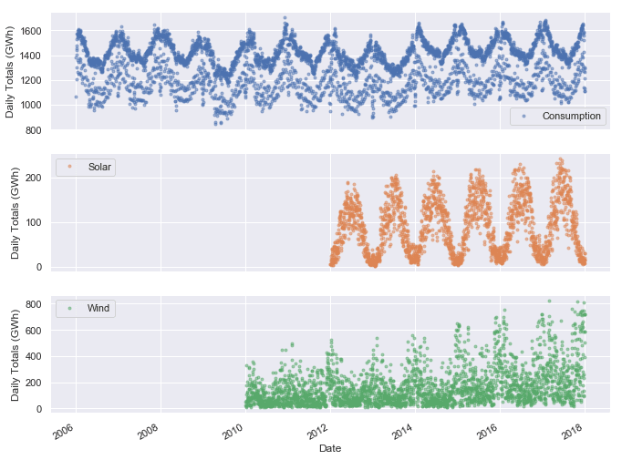
INTRO TO TIME DATA
PANDAS WITH TIME: INTRO
In Pandas, it is fundamental to use time variables, which allows us to work with time information in dataframes. The datetime library is also used in the same way as we explained before, but it has some specific functions for pandas that are characteristic of time series. In this section we will focus mainly on:
Processing in pandas of temporal variables
Operations with temporal fields
General for time data
Specific for time series
Displaying temporal variables

Slide 16
INTRO TO TIME DATA
PANDAS WITH TIME: PROCESSING I
These basic operations are similar to those we saw in the previous section:
Creating the dataframe:
From time series data: pd.date_range(start = '2017-1-1', periods = 7, freq ='d)
Read a file with a time variable: pd.read_csv(file, parse_dates = [])
Transform the index: In pandas, having the index as a date offers advantages in terms of efficiency
Read data with index: pd.read_csv(file, index_Col = [])
Change the index: df.set index('date', inplace = True)
Filtering with the index:
Can be filtered directly if we have a time-related index
Another option is to filter a date field with logical operators
Feature Engineering
It is interesting to create some variables in the models or to do filtering and groupby. It is done in a similar way as the previous case

Slide 17
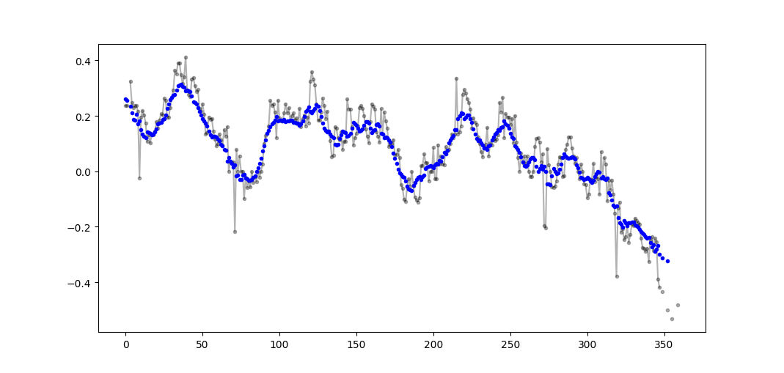
INTRO TO TIME DATA
PANDAS WITH TIME: PROCESSING II
Other more specific time series characteristic operations. They are more efficient with the index as a time date:
Index frequency change
df = df.as freq('D'), although it also resamples
Move a value through rows
Forwards: shift
Backwards: shift(periods = -1)
Operations between rows
Difference: Difference between values diff
Percentage difference: Pct Changes pct_change
Moving average (of a Period): rolling

Slide 18
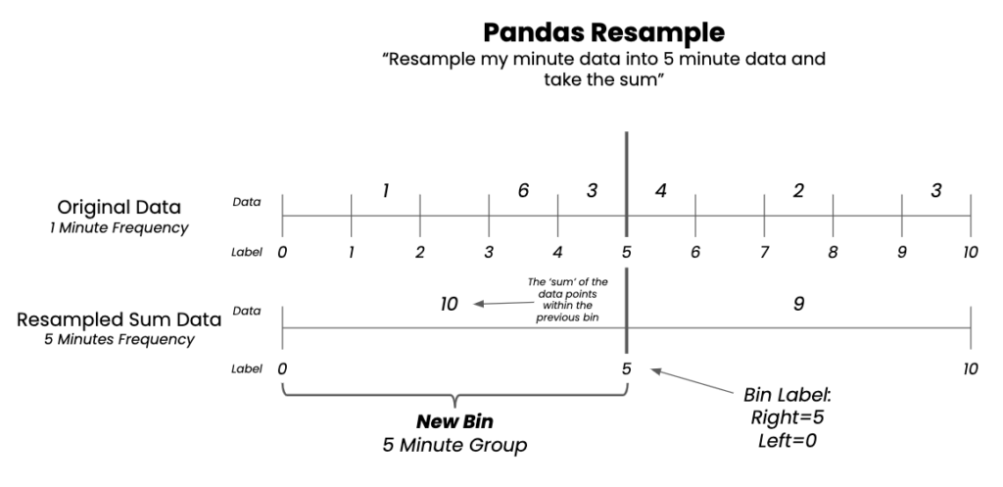
INTRO TO TIME DATA
PANDAS WITH TIME: RESAMPLING
Time series give us a value in an instant of time. Sometimes, it is necessary to adapt the values to other instants/time intervals, either by:
Need of greater granularity: longer intervals
Need of lower granularity: shorter intervals
Need of other intervals: different intervals
Pandas offers the function of resampling the dataframe without the need to make a groupby (although it can also be combined), resampling can be done in many ways:
Backwards (backfill): Fills in gaps with values ahead.
Forward (forwardfill): Fills in gaps with previous values.
With the average or interpolating: using both values
This method is similar for the filling of NAs

Slide 19
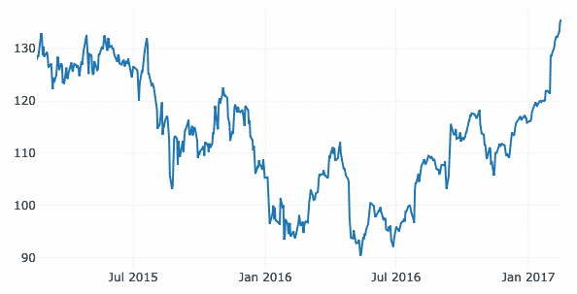
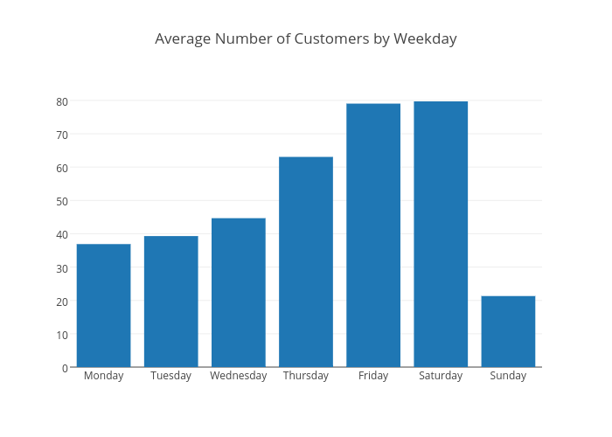
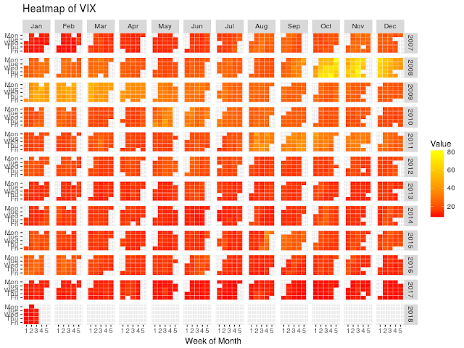
INTRO TO TIME DATA
PANDAS WITH TIME: VISUALIZATION
The visualization of time series helps your understanding, to appreciate trends, outliers and other patterns such as seasonalities quickly. They are present in all stages of the process: from the EDA, till the display of results. We will use the library plotly for Python, although there are many alternatives allow us to display this type of visualizations. The graphs are similar to those designed for numerical variables, but let's separate three use cases:
Continuous
Grouped
Specific
They are the most typical visualizations for temporal values and show us the evolution of a variable over time. With the X axis with time and on the y axis and the variable analyzed. Each point represents a sample. Most of the time it is a line plot, although we can also use scatter, bars, area plots.
They are used to represent groupings of data, in this case related to some temporary variable. They are common and can help you see patterns related to seasonality (whether it's day of the week, month, hour). The most common are bar or box charts.
For temporal data, there are other types of graphs specific to this use case. They are visual and can have different aspects, although they do not generate an accurate and comparable output. Heatmaps are a type of this visualization. There are other specific graphs such as correlation, which we will see later.

Slide 20

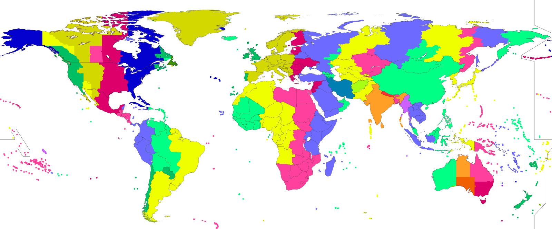
INTRO TO TIME DATA
TIME ZONES
Time zones are areas of the planet that have the same definition of time i.e., the same time at the same moment. Mainly they correspond to the meridian (latitude) towards the east it increases, towards the west it decreases, although it is also influenced by other socio-political aspects.
In addition, you have to be careful with some aspects, especially when it comes to industries that operate globally:
Time differences region/country: That translate into the non-simultaneity of the day and possible changes of dates
Changes in time: Adds or takes away one hour (twice a year)
For this reason, it is advisable to work with UTC until the final stages of the projects, in which it is convenient to translate the local time.
Two key tasks to work with timezones:
Know the timezone: There are functions that relate regions to TZ
Calculate the necessary time: There are default functions.
Another aspect that is complex is the difficulty of dealing with different time zones in the same dataframe or series.

Slide 21
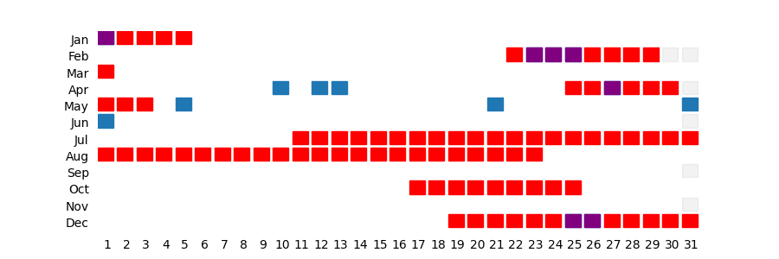
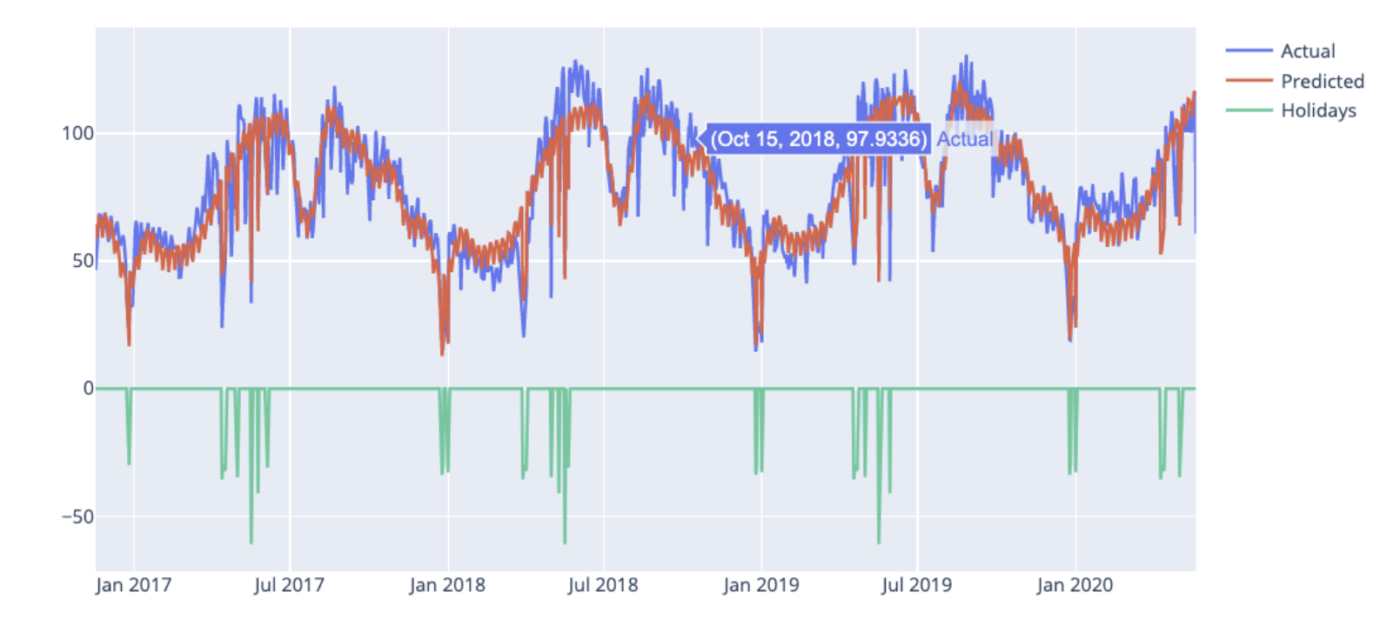
INTRO TO TIME DATA
EFFECT OF HOLIDAYS
Holidays are an important variable that can have a great effect on activity in various industries, and therefore, on our models. The effect depends on the type of problem and the treatment of these days can become complex due to:
They are specific at the national and regional levels.
They do not always correspond to specific dates (third Monday of a month), they can be dynamic and vary over the years, and even disappear holidays from the calendar. Holiday eves (and even later days) may also be affected.
With these criteria, it is necessary to obtain a calendar that includes all the festive dates year by year. There are some specific libraries that allow it (holidays in Python). In addition, some time series models, such as Prophet, include the possibility of taking this effect into account automatically.

Slide 22

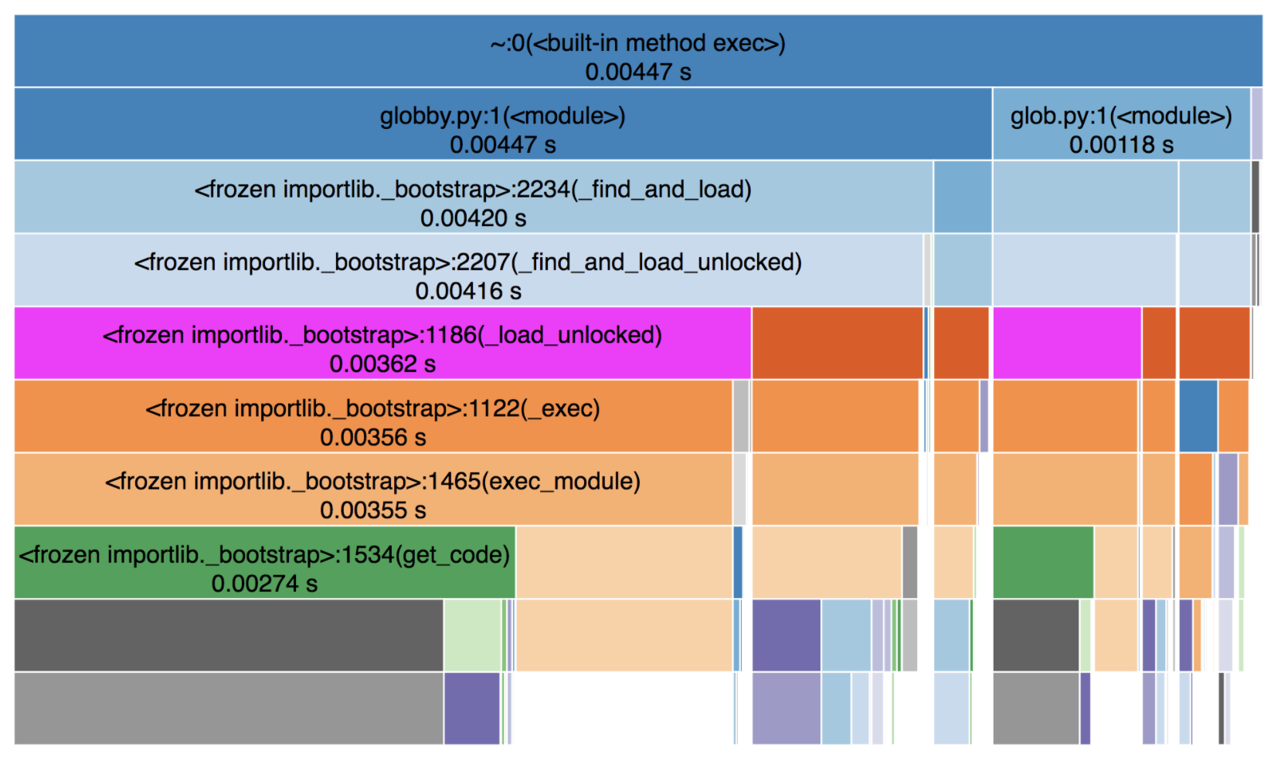
INTRO TO TIME DATA
CODE RUNTIME
Another aspect to take into account is the computing time. How long does our code need to run? Whether we have to make immediate answers, or if we operate with large volumes of data, it is necessary to take into account that time.
There are different alternatives to do this calculation:
Using the time() library between code: Make two calls to the function now and calculate the time difference between the two
Using a specific library: The timeit library allows us to measure the execution time of small code snippets. Several iterations are made to have more precision.
In case we want something more visual there are other more complex libraries that allow us to know these elapsed time more precisely and with greater granularity: snakeviz

Slide 23
INTRODUCTION TO TIME SERIES
02

Slide 24
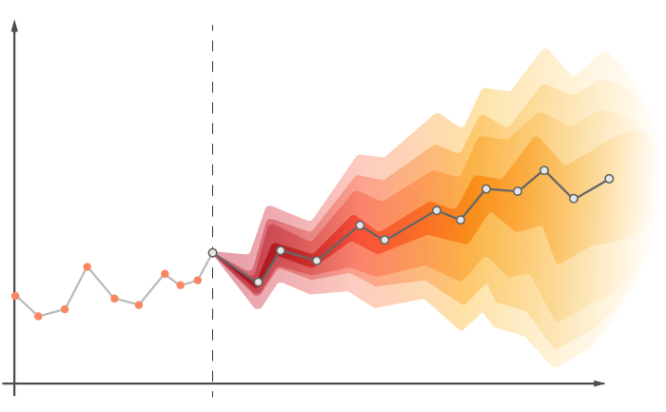
TIME SERIES
TIME SERIES: DEFINITION
A time series is an ordered sequence of observations each of which is associated with a moment of time.
This is a special form of regression, why?
• the order of the data is fundamental: we have an ordered data set
• the assumption of independence does not hold since, in general, observations are dependent on each other, and the nature of their dependence is of interest in itself.
CAUTION WHILE SAMPLING!
y
tiempo
Series Temporales
Notes:
Time Series is basically a dataset collected through time.
Since we are doing sampling with adjacent points in time, we naturally introduce a correlation.

Slide 25
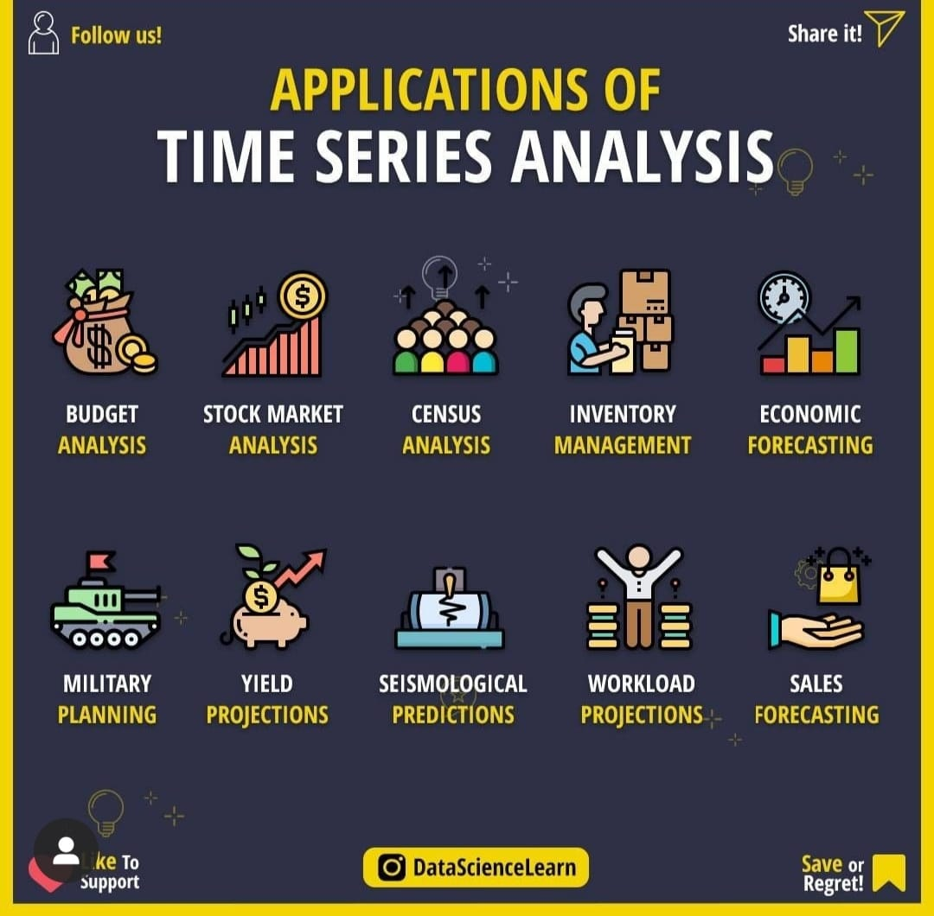
TIME SERIES
TIME SERIES: APPLICATIONS
The objectives that can be achieved when analyzing a time series are very diverse, but among the most important are:
Describe the past, describe the characteristics of the series, in terms of its components of interest.
Predict the future, predict future values of the variables.
There are also other use cases related to the above, such as knowing the relationship between variables or creating simulations of the values.
The applications are very varied, and there are time series in all industries: sales or stock analysis, process and quality control, stock prediction, profitability analysis, climatology and pollution, among others.
Series Temporales

Slide 26
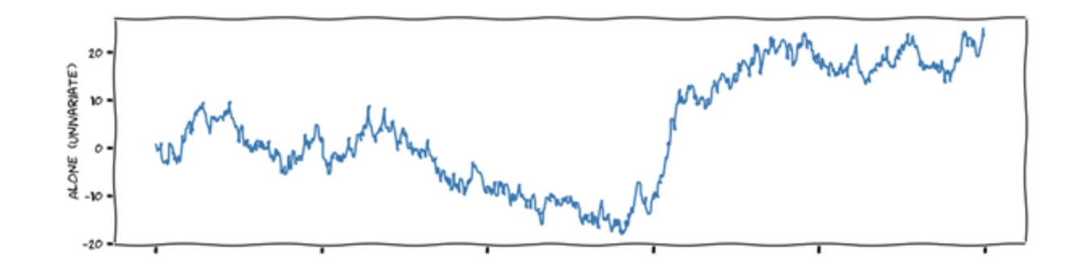
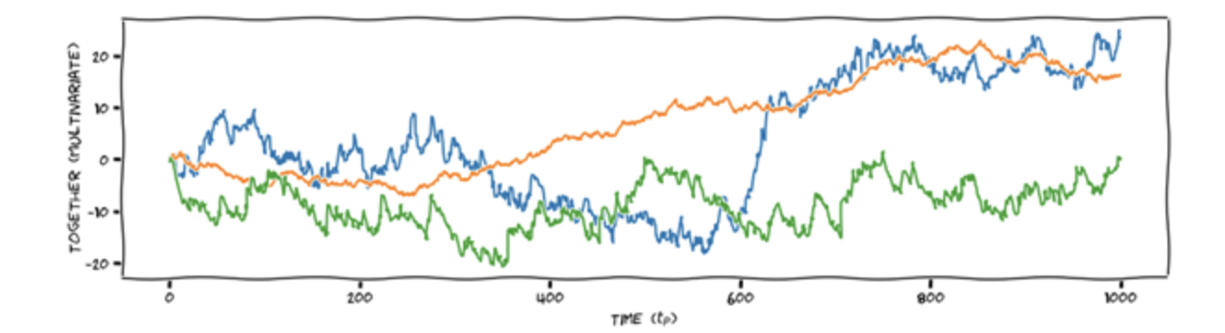
TIME SERIES
TYPOLOGY OF MODELS
Modelo Univariante
Depending on the variables used, Time Series models can be:
Univariate: To calculate the values, only the past value of the time series that varies over time is used. These are the simplest.
Multivariate: In addition to the past value, more variables are used to predict the future value of the time series.
Modelo Multivariante

Slide 27
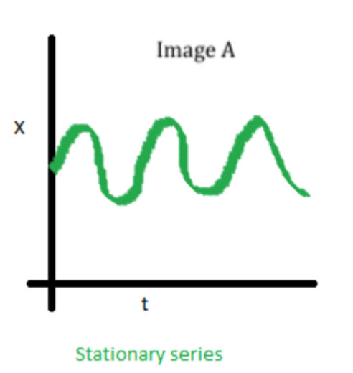
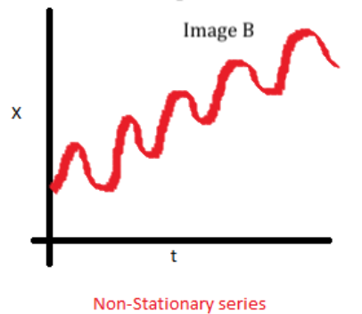
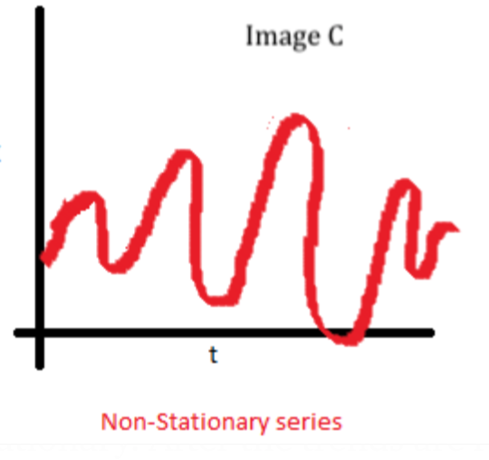
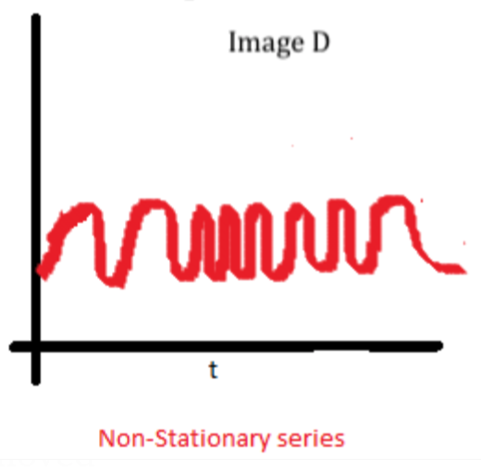
TIME SERIES
TIME SERIES: STOCHASTIC PROCESSES
❌ Your average evolves over time
From an intuitive point of view, a stochastic process can be described as a sequence of data that evolves over time. Time series are defined as a particular case of stochastic processes. A stationary stochastic process is a stationary process has the following characteristics.
Constant mean: E(Xt) = E(Xt+k)
Constant variance: V(Xt) = V(Xt+k)
Autocovariance does not depend on time
It is difficult to ensure that a series is totally stationary, but it is convenient. The main causes are Seasonality Trend. It is important to adapt stationary series. To check if it is a series is stationary
ADF Test (Augmented Dickey-Fuller Test)
KPSS
❌ Its variance evolves over time
❌ Your covariance evolves over time
Notes:
https://medium.com/geekculture/vector-auto-regression-for-multivariate-time-series-forecasting-9334d29591f3

Slide 28
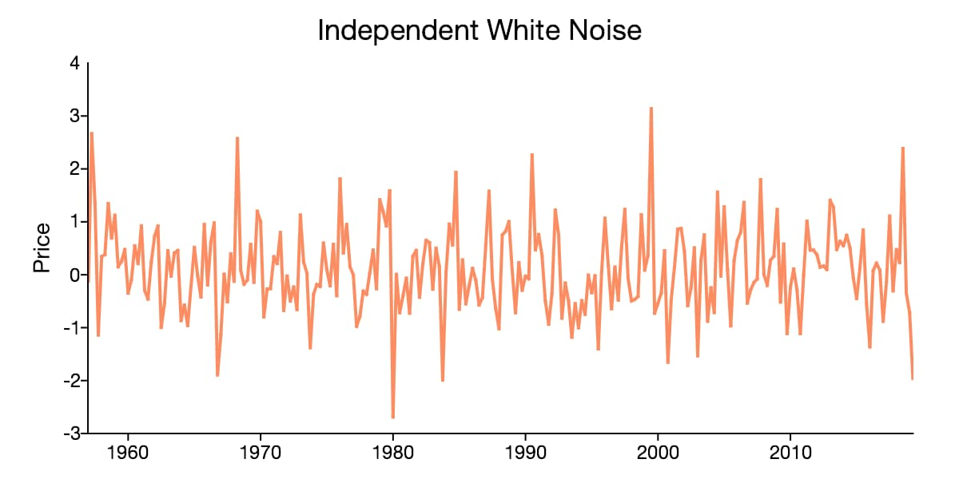
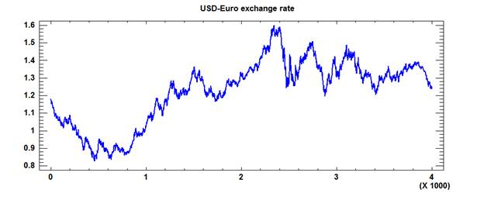
TIME SERIES
TIME SERIES: CONCEPTS
Ruido Blanco
White Noise: This is a random signal (Stochastic Process) characterized by the fact that the values of the signal at two different times do not have statistical correlation. Conditions for white noise
Zero Average Condition
Variance is constant
Variance is not correlated
Random Walk: It is a stochastic process in which value depends on the previous value by adding an unpredictable change (random steps), that is, the difference is white noise. In this case, the best forecast of the value is its previous value.
Random Walk

Slide 29
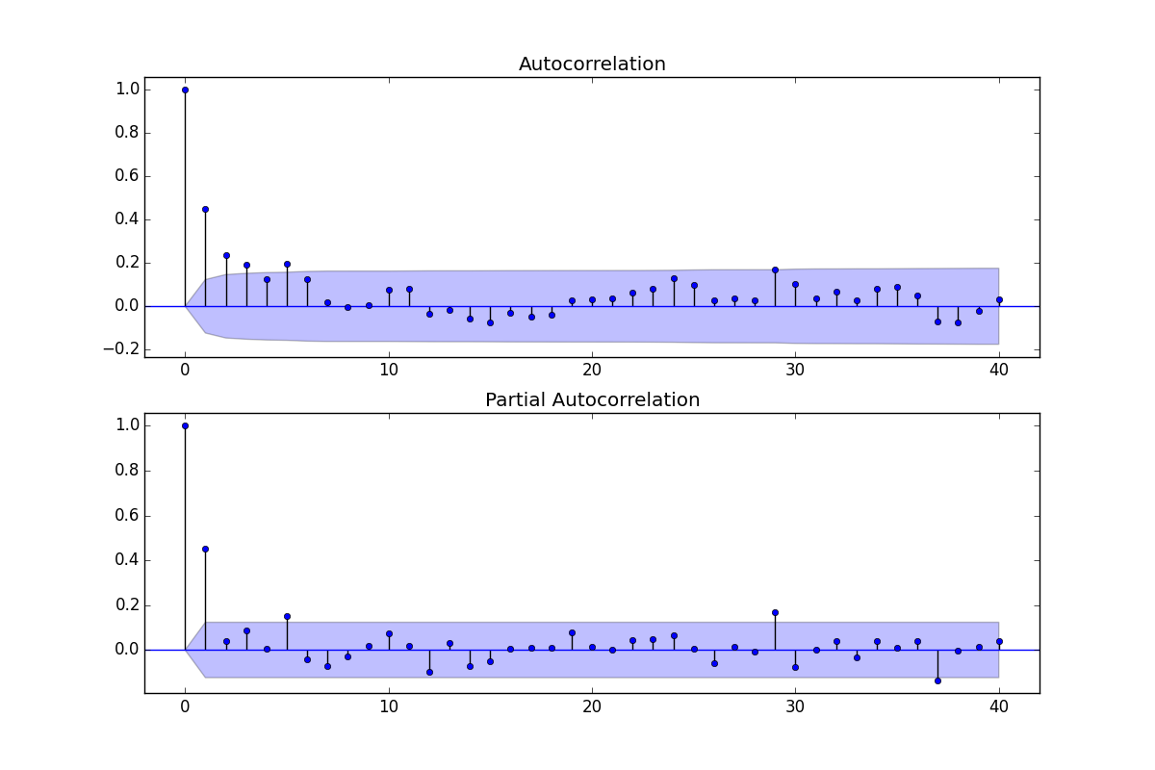
TIME SERIES
TIME SERIES: AUTOCORRELATION
ACF - Autocorrelación
Sometimes in a time series it happens, that the values that a variable takes in time are not independent of each other, but that a certain value depends on the previous values, there are two ways to measure this dependence on the variables:
Autocorrelation Graph: shows the Pearson correlation between the series and the “lagged" series (previous values of the series). This graph allows us to determine what is the degree q of the MA part.
Partial Autocorrelation Chart: shows the strength between the series and previous values eliminating any intermediate impact. Yt is "influenced" by the value in Yt-1, Yt-1 in turn is influenced by Yt-2. Therefore, in the partial autocorrelation graph we want to see what impact does Yt-2 on Yt, if we eliminate the impact of Yt-1 on Yt. Therefore, we see the "direct" impact of Yt2 to Yt. This graph allows us to determine what is the degree p of the AR part.
The Ljung-Box test allows us to jointly test whether all autocorrelation coefficients are equal to 0.
.
Values outside the shaded area are statistically significant values and can be used to model any time series.
ACF - Autocorrelación Parcial
Notes:
https://towardsdatascience.com/time-series-decomposition-in-python-8acac385a5b2

Slide 30
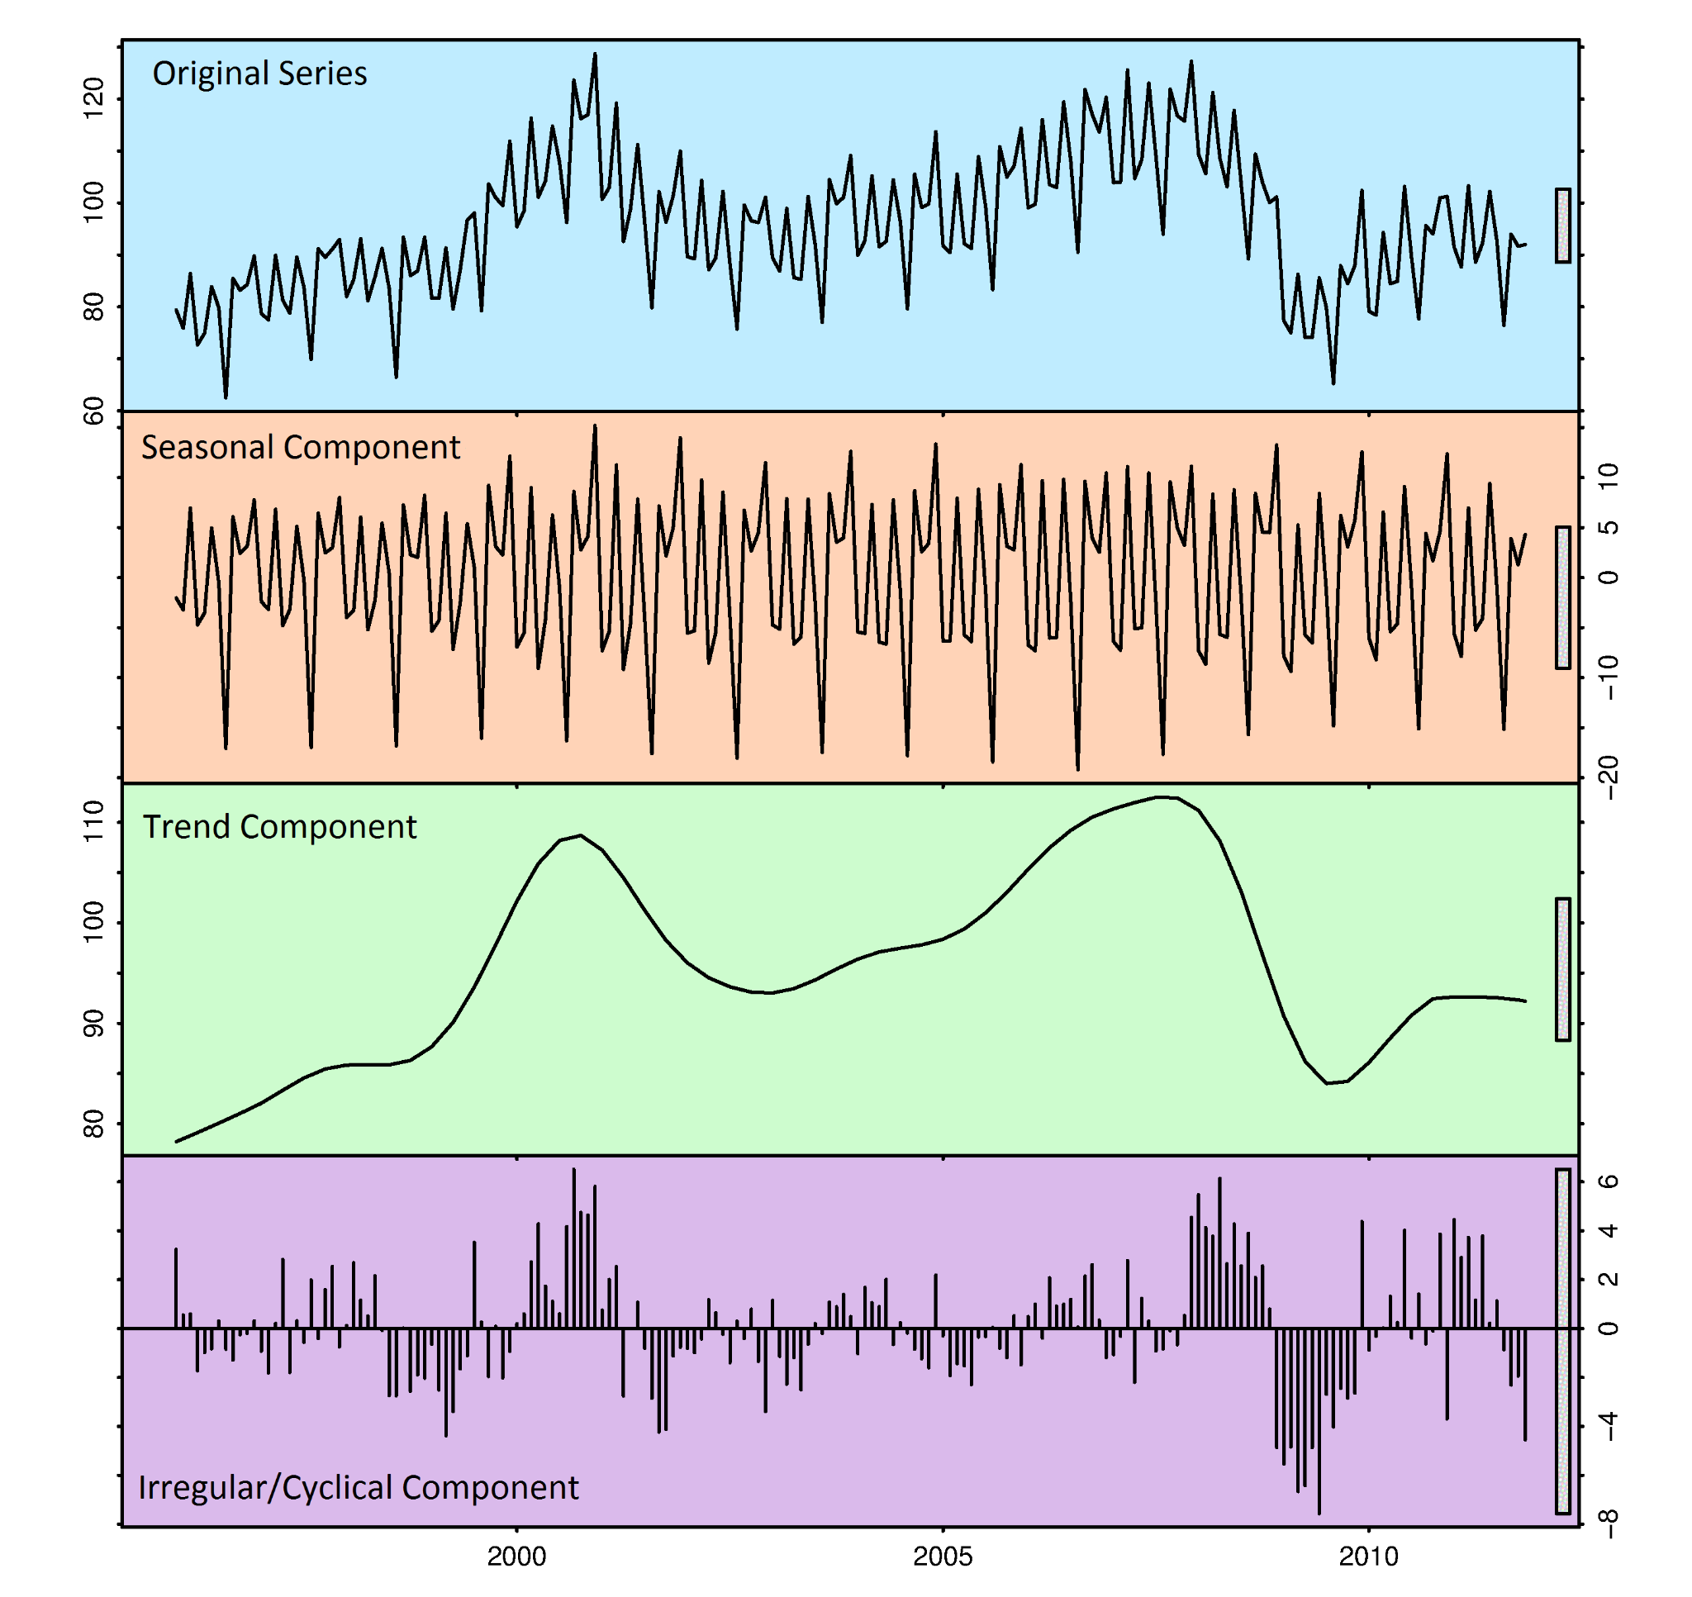
TIME SERIES
TIME SERIES: DECOMPOSITION
Time series decomposition is a technique that allows us to divide a series into certain categories. Each category is represented by characteristic patterns:
Seasonality describes the periodic signal in a time series. It usually corresponds to the seasonality of the year (monthly or quarterly).
Trend refers to the evolution over time, whether it remains constant, increases or decreases.
Noise is the variability that cannot be explained by the model. That is, the difference between the seasonality values and trend values, and the noise.
Cyclical component is a period component more frequently than seasonal. In most cases, it refers to the week.
This separation helps us understand the different parts/factors of our time series. It can be done in Python directly.
Series Temporales
Notes:
https://towardsdatascience.com/time-series-decomposition-in-python-8acac385a5b2

Slide 31
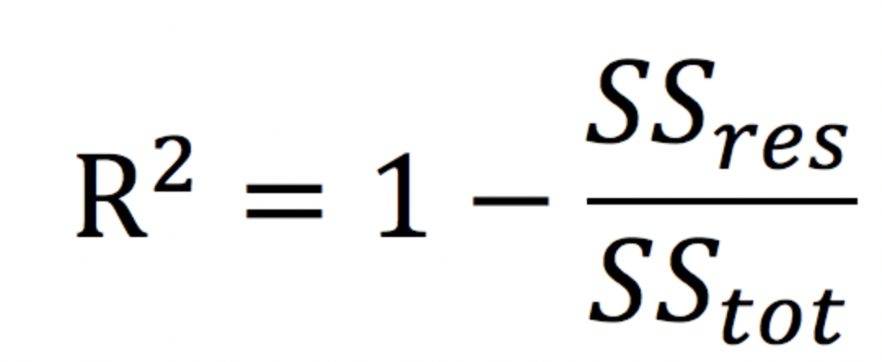
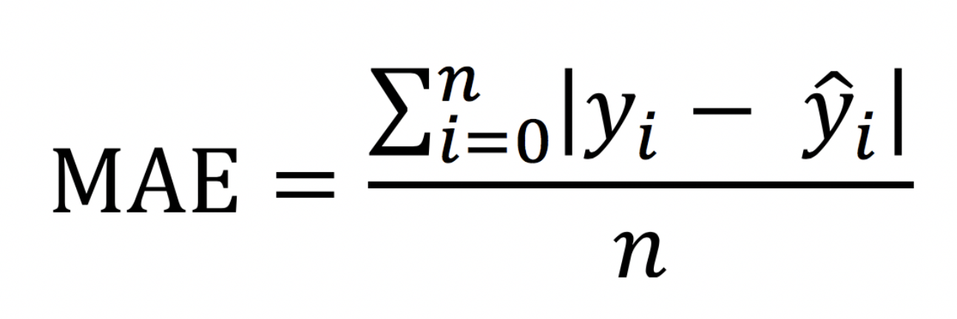
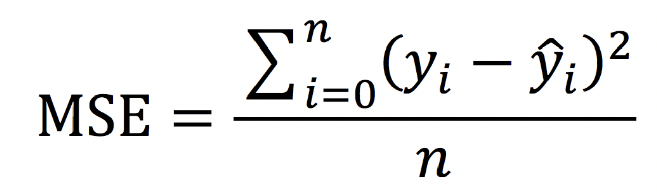
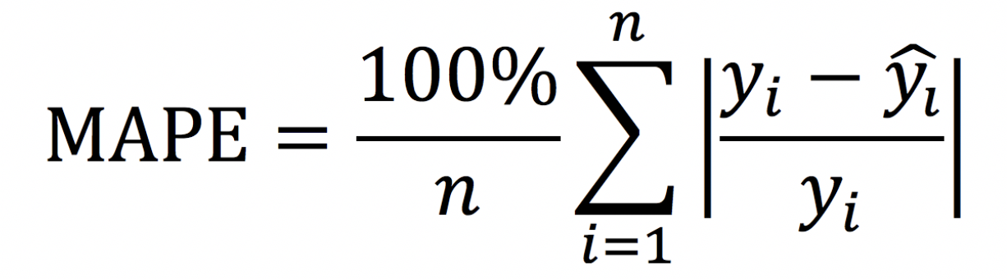
TIME SERIES
ERROR METRICS
Evaluating the time series is necessary to know the accuracy of the developed model. There are numerous metrics based on the use case, which match the metrics for evaluating typical regression problems.
R²
R squared It is the best known measure in linear regressions. It refers to the amount of variance that can be explained by the dependent variable. 0 to 1, with values closer to 1 indicating more variance can be explained.
MAE
Average absolute error. It is the mean absolute value of the errors. What error can you expect on average? Robustness against outliers, simple interpretation, and comparable
MSE
Mean square error is the standard deviation of the residuals (errors). In other words, define how concentrated are the errors, penalizing the highest. THE RMSE is also used.
MAPE
It is similar to the previous ones, but includes a division between the term that 'relativizes' it, so it is a percentage. It may be useful to know more about the goodness of the model.
Notes:
https://joydeep31415.medium.com/common-metrics-for-time-series-analysis-f3ca4b29fe42
https://medium.com/analytics-vidhya/mae-mse-rmse-coefficient-of-determination-adjusted-r-squared-which-metric-is-better-cd0326a5697e

Slide 32
MODELS (S)ARIMA(X)
03

Slide 33
TIME SERIES MODELLING
ARIMA: DEFINITION
ARIMA models are designed for time series modeling taking into account the dependence between the data, that is, each observation at a given time, is calculated based on the previous ones. The final value is a linear function of past data and errors due to chance. In addition, in its variants, it allows you to add seasonal information and external variables to complete the model. For resolution, there is Box and Jenkins' methodology that defines the steps.
S A R I M A X
Seasonality
Autoregressive
Integrative
Moving Average
Exogenous

Slide 34
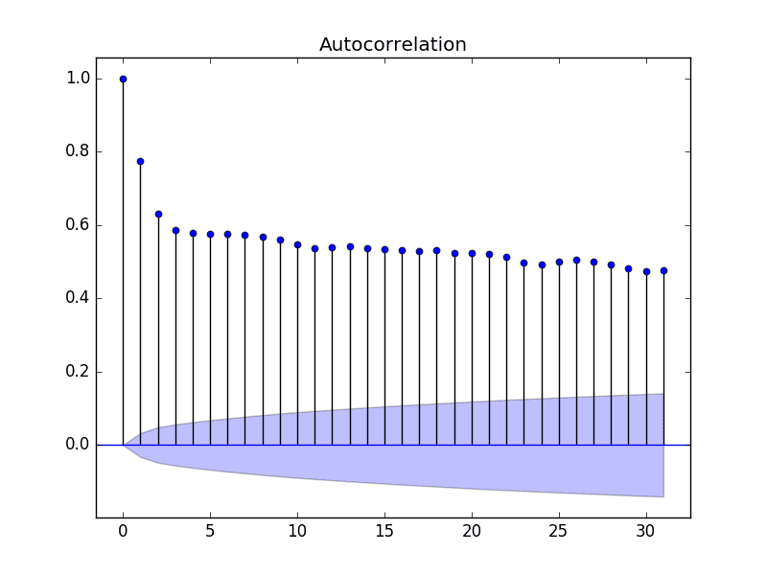
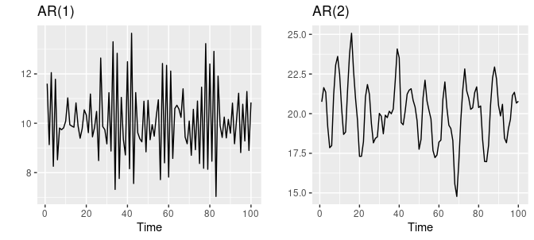
TIME SERIES MODELLING
AR MODELS: INTRODUCTION
Autoregressive models are based on the idea that the current value of the series can be explained as a function of past values, where the order determines the number of delays needed to forecast a current value. In addition, there is a linear dependence between the output (the output variable) and its previous values.
The order is known as p, and the simplest case is that of order one
AR(p) Yt = Φ1Yt-1 + Φ2Yt-2 + Φ3Yt-3 + αt
Notes:
El proceso AR simple es AR(0), que no tiene dependencia entre los términos. (Ruido Blanco)

Slide 35
TIME SERIES MODELLING
AR MODELS: EXAMPLE
Yt = Φ1Yt-1 + Φ2Yt-2 + Φ3Yt-3 + αt
Date | Value
T1 | Y1
T2 | Y2
… | …
Tn | Yn
Lags1 | Lags2 | Lags3
Y2 | Y3 | Y4
Y3 | Y4 | Y5
… | … | …
NaN | NaN | NaN
Series Temporales

Slide 36
TIME SERIES MODELLING
AR MODELS: QUESTIONS
Once we know the AR models, we are asked two main questions:
Yt = Φ1Yt-1 + Φ2Yt-2 + Φ3Yt-3 + αt
How many lags will I use in my model (what is my p)?
How to estimate the coefficients Φ (phi)?
Any autocorrelation in a stationary series can be rectified by adding sufficient AR terms. Therefore, we initially take the order of the term AR that will be equal to as many lags that it crosses the significance limit in the PACF chart.
It is also convenient to talk about AIC and BIC, which measure the goodness of the model. It is better to reduce the value. AIC: Akaike Information Criterion, Better predicts the future BIC: Bayesian Information Criterion Simplifies more towards simpler models and allows a better understanding of the past
Once we have the p and q, we use statistical software or a library of our programming language that through OLS (ordinary least squares) would determine the coefficients of the model that best fits my time series.
s.

Slide 37
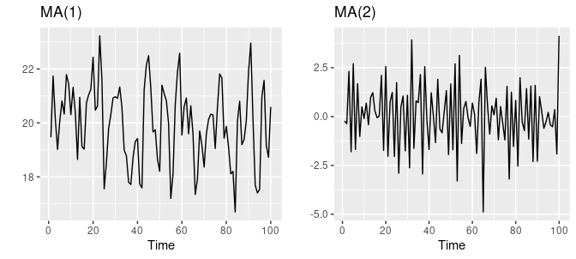
TIME SERIES MODELLING
MA MODELS: INTRODUCTION
A moving average model is an autoregression where the regressors are the error terms of each period t. The moving average model specifies that the output variable that depends linearly on the current value (and stochastic previous values)
Although they have a common name and some similarities, not to be confused with the concept of moving averages.
Yt = Θ1αt-1 – Θ2αt-2 – Θ3αt-3 + αt

Slide 38
TIME SERIES MODELLING
MA MODELS: EXAMPLE
μ: historic mean | 10
Θ (theta): | 0,5
αt-1 = μ – Yt-1
Y(target)
X(train)
N | Estimated Value | Real Value | Error
1 | 10,00 | 11 | 1
2 | 10,50 | 13,00 | 2.50
3 | 11,25 | 9,99 | -2,25
4 | 8.88 | 10,00 | 1,13
5 | 10,56 | 9,99 | -1,56
6 | 10,89 | 12,00 | 1,11
Date | Value
T1 | Y1
T2 | Y2
… | …
Tn | Yn
Error1 | Error2 | Error 3
α2 | α3 | α4
α3 | α4 | α5
… | … | …
NaN | NaN | NaN
Yt = Θ1αt-1 – Θ2αt-2 – Θ3αt-3 + αt

Slide 39
TIME SERIES MODELLING
MA MODELS: QUESTIONS
We return to ask ourselves the key questions that allow us to understand
Yt = Θ1αt-1 – Θ2αt-2 – Θ3αt-3 + αt
How many "errors" will I use in my model (what is my q)?
How to estimate the coefficients Θ (theta)?
Just as we have seen the PACF chart for the number of AR terms, we can see the ACF chart for the number of MA terms. An MA term is, technically, the error of delayed forecasting. The ACF indicates how many MA terms are required to eliminate any autocorrelation in the stationary series.
It can also be performed by doing tests, seeing results and analyzing parameters such as BIC AND AIC.
Once we have the p and q, we use statistical software or a library of our programming language there are functions that make the calculation more direct and efficient.

Slide 40
TIME SERIES MODELLING
ARMA MODELS: INTRODUCTION
Now that we have seen 2 different approaches to modeling univariate time series, we can ask:
Can we combine the two approaches: autoregressive AR(p) and moving averages MA(q) to get the complete result
s.
AR (p = 3)
MA (q = 3)
Yt = Φ1Yt-1 + Φ2Yt-2 + Φ3Yt-3 + αt
Yt = Θ1αt-1 + Θ2αt-2 + Θ3αt-3 + αt
ARMA(pq) = AR(p)MA(q)
Yt = Φ1Yt-1 + Φ2Yt-2 + Φ3Yt-3
+ Θ1αt-1 + Θ2αt-2 + Θ3αt-3 + αt

Slide 41
TIME SERIES MODELLING
ARMA MODELS: IDENTIFICATION
Jen Bookings methodology allows us to solve time series problems by steps
Process | Autocorrelation Function | Partial Autocorrelation Function
MA(q) | Only the first q coefficients are significant. The rest are abruptly canceled out. (coef. 0 for lag > q) | Attenuated exponential fast decay or sine waves.
AR(p) | Attenuated exponential fast decay or sine waves. | Only the first p coefficients are significant. The rest cancel out abruptly (coef. 0 for lag > p)
ARIMA(p,d,q) | Irregular behavior in the lags (1,…, q) with q peaks. Decline in lags after q. | Decline in attenuated exponentials and sine waves. No early zero lags.

Slide 42
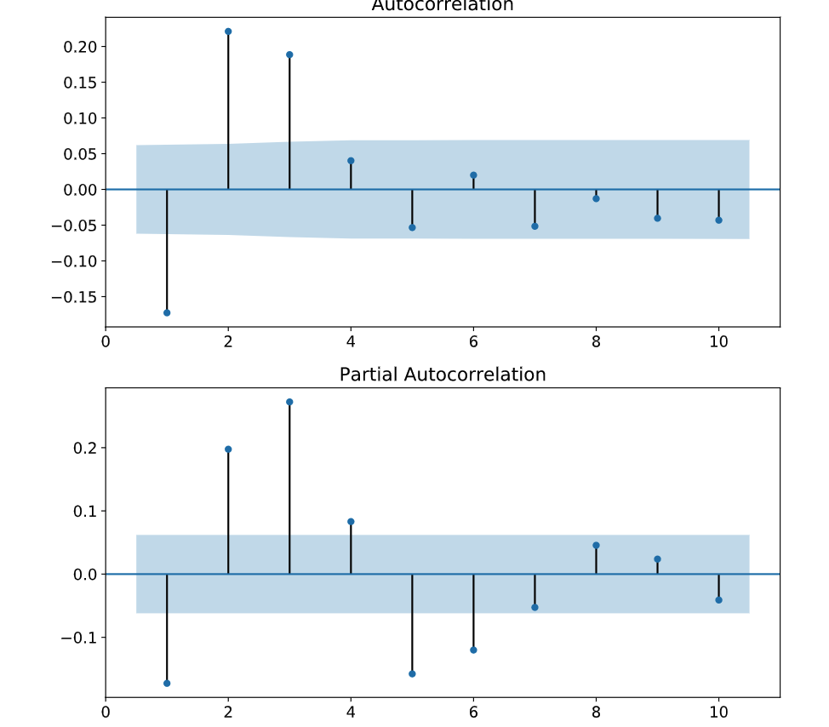
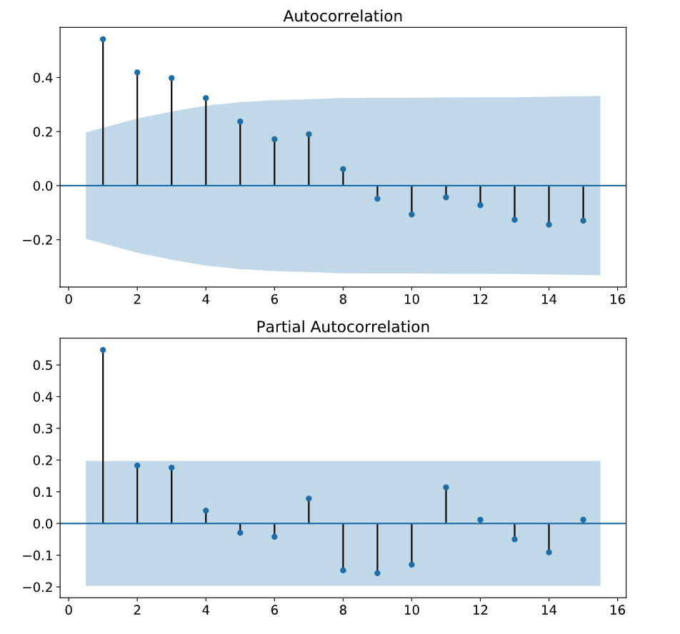
TIME SERIES MODELLING
ARMA MODELS: IDENTIFICATION
A couple of examples
MA(3)
AR(1)

Slide 43
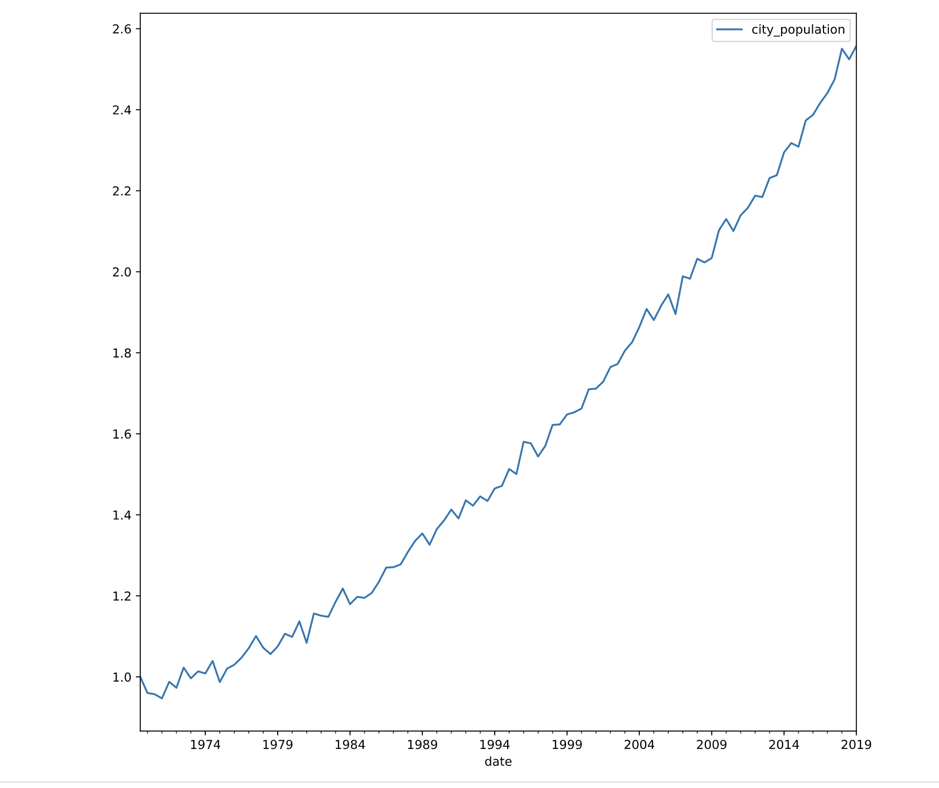
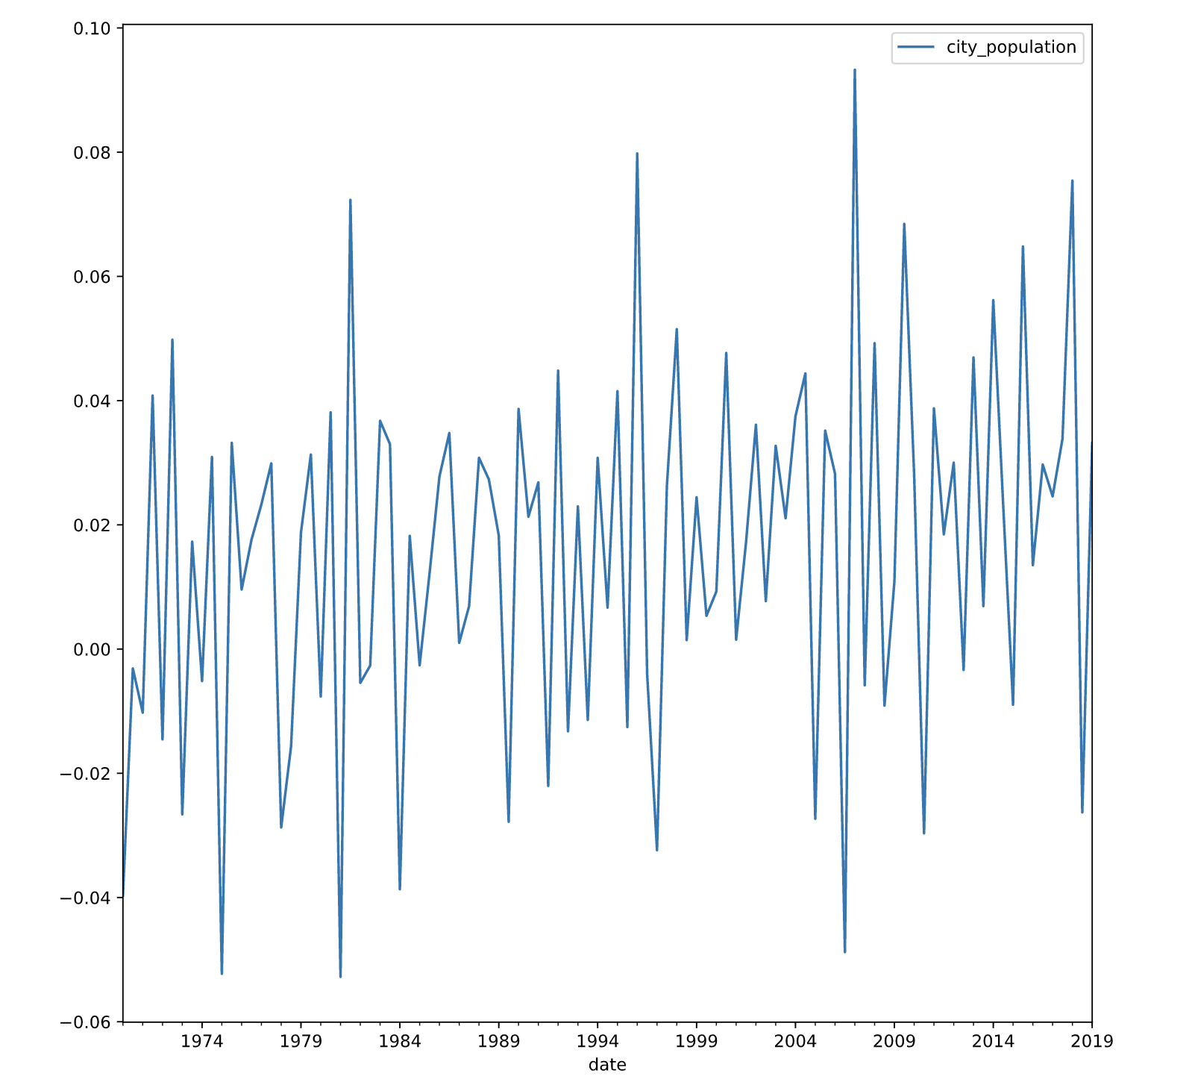
TIME SERIES MODELLING
AR MODELS: THE INTEGRAL PART
Very few time series in the real world are stationary. Most have trend, non-constant variance and seasonal variations.
The integral part represents the process of differences between successive values to achieve the condition of stationarity. For linear trends, the first difference (first order) is sufficient, although more differentiations may be necessary for more complex cases.
The order of the integral part refers to the number of differences between the values necessary for the values for the series to be stationary
Wt = Yt - Yt₁

Slide 44
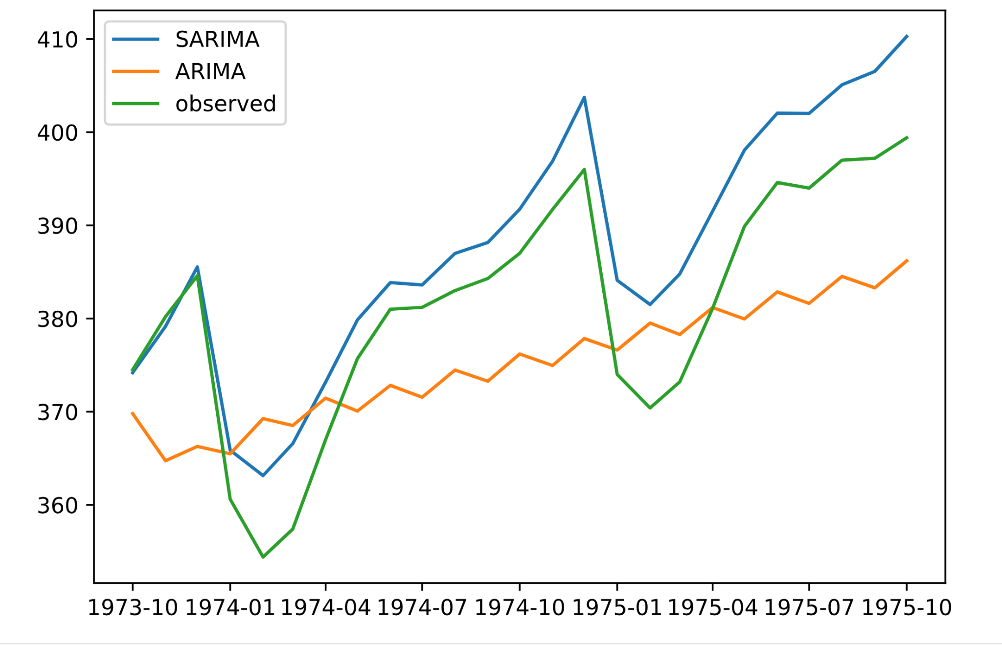
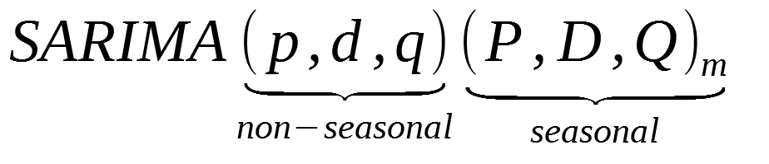
TIME SERIES MODELLING
ARIMA MODELS: SEASONALITY (SARIMA)
In time series, there is often a cilician correlation with more distant periods (not only the most recent ones). To take into account this feature of time series, we have the SARIMA model.
The SARIMA Models are an extension to the ARIMA model that analyzes the univariate model and includes a seasonality component in the model. It is necessary to know the period of seasonality to include it in the model.
The seasonal part is composed of terms similar to the traditional components, but the lag period is related to the period of seasonality (either monthly, weekly)

Slide 45
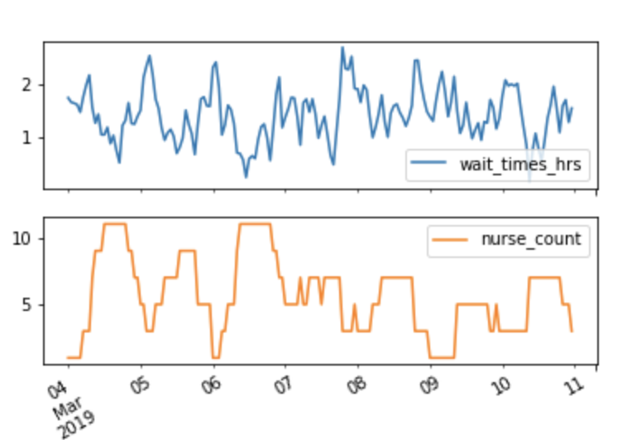
TIME SERIES MODELLING
ARIMA MODELS: ENDOGENOUS VARIABLES (ARIMAX)
In most temporal models, external variables, which are not included in the model, that can have an impact on the result also have an effect. ARIMA type models are an extension of the ARIMA model that include an exogenous variable (X), so they are designed for multivariate series (which depend on more than one variable). This variable can be of different types.
From the mathematical point of view, it is a new term that includes a variable that depends on time, The coefficient of the external variable, does not represent its importance in the model, but its relationship with the other terms to predict the variable. Beware of overfitting!
Yt = BXt + Φ1Yt-1 + Φ2Yt-2 + Φ3Yt-3 + Θ1αt-1 + Θ2αt-2 + Θ3αt-3 + αt

Slide 46
TIME SERIES MODELLING
ARIMA MODELS: BOX JENKINS METHODOLOGY
Jen Bookings' methodology allows us to solve time series problems by steps using the info above
IDENTIFICATION
SELECTION
DIAGNOSIS
PREDICTION
you use the time series "Y" as well as any additional information available to "narrow down" a set of possible models that may have generated the time series.
The tools used are graphics such as autocorrelation and/or partial autocorrelation to choose the degree of the ARMA model (p,q)
in this phase, the coefficients of the model that we have "limited" in the first step are estimated using computer software.
Some are based on methods already known as squared methods.
statistical tests are performed to see the goodness of the models. Normally the distribution of residuals is analyzed (if they follow a normal distribution).
Important to know metrics and objectives.
once we have the best model, we can use it to make future inference (forecasting). It is important to use Confidence Intervals.

Slide 47
TIME SERIES MODELLING
ARIMA: DISCLAIMER!!
auto
Although ARIMA models are the basic model of time series theory, in practice, working with this model is more complicated for several reasons.
Many of the assumptions we made about the series to be able to use ARMA models are not always fulfilled in real life (stationary series etc). Normally it is asked to make a forecasting of many series and not just one. In these cases, we can analyze each series and see the degree of the model and make the relevant transformations.
There are many external variables that can provide a lot of information but whose incorporation into the ARMA model is not an easy task. ARMA models were developed in the 1960s but since then many other, more versatile, efficient and easy-to-use forecasting techniques have emerged or become popular.
For these reasons, in the industries, they opt for ones such as boosting XG boost or Prophet, which we will see in future topics

Slide 48
PREDICTION WITH PROPHET
04

Slide 49


PREDICTION WITH PROPHET
PROPHET: INTRODUCTION
Prophet is an open source tool developed by Facebook that is used for time series models, which is very popular today.
This technique to predict the temporal values of a series is based on the adjustment of seasonalities: annual, weekly and daily, and has the possibility of including vacations, which can have a great effect on the output.
Prophet's performance improves when you use series with seasonal effects and have a broad history. In addition, it is robust to missing data and includes the treatment of extreme values (outliers).

Slide 50
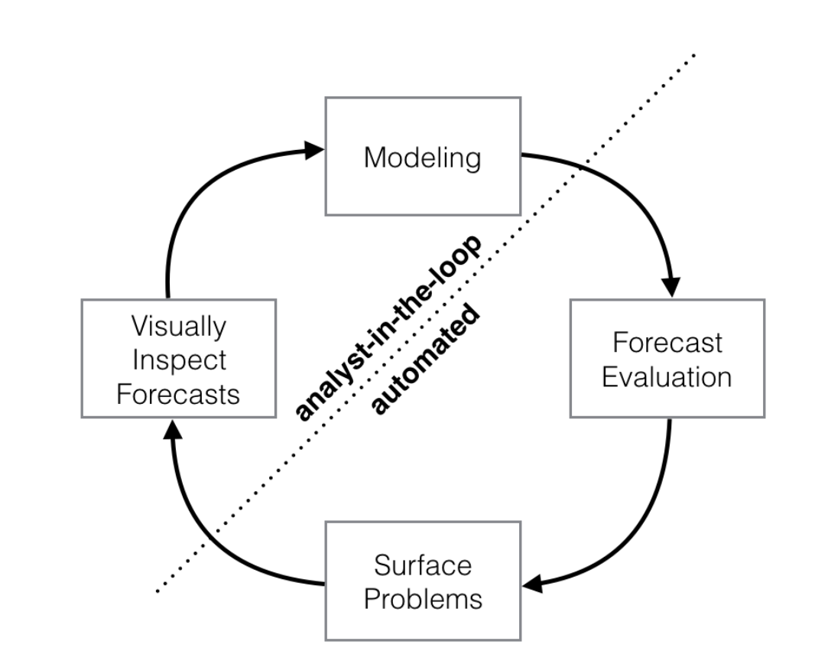
PREDICTION WITH PROPHET
PROPHET: FACTORS TO CONSIDER
The following factors must be taken into account when trading with Prophet
Hourly and daily information can be included, and a sample of a few months is needed (a year if it can be included).
Temporalities that affect are taken into account: day of the week, station of the year, and events.
Can handle NAs and outliers.
It also takes into account historical trends and specific events that affect the target variable.
Similarly, it is possible to detect trends in evolution that are not linear.

Slide 51
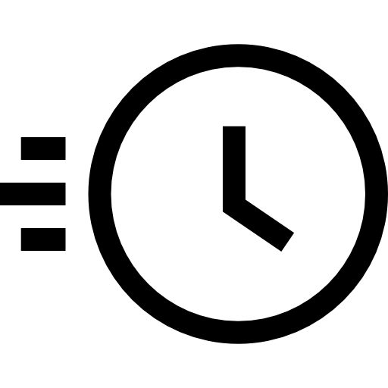



PREDICTION WITH PROPHET
PROPHET: CHARACTERISTICS
Fast and Accurate | Efficient and Automatic | Flexible and Interpretable | Available for R and Python
Used by many companies (Facebook) due to its better performance than similar algorithms | No major transformations are necessary to apply it and it is robust | The procedure allows to include greater complexity by adding parameters | It is implemented and can be used in different programming languages

Slide 52
PREDICTION WITH PROPHET
PROPHET: MATHEMATICAL BASIS
y(t) = g(t) + s(t) + h(t) + E(t)
y(t) -> Numerical variable to estimate - Target
g(t) -> A linear or logistic growth curve trend in pieces. Prophet automatically detects change points in the initial data. s(t) -> Annual Seasonality Component, modeled through Fourier series and Weekly seasonality Component, using simple variables h(t) -> A list of holidays provided by the user E(t) -> A difference in the predicted value

Slide 53
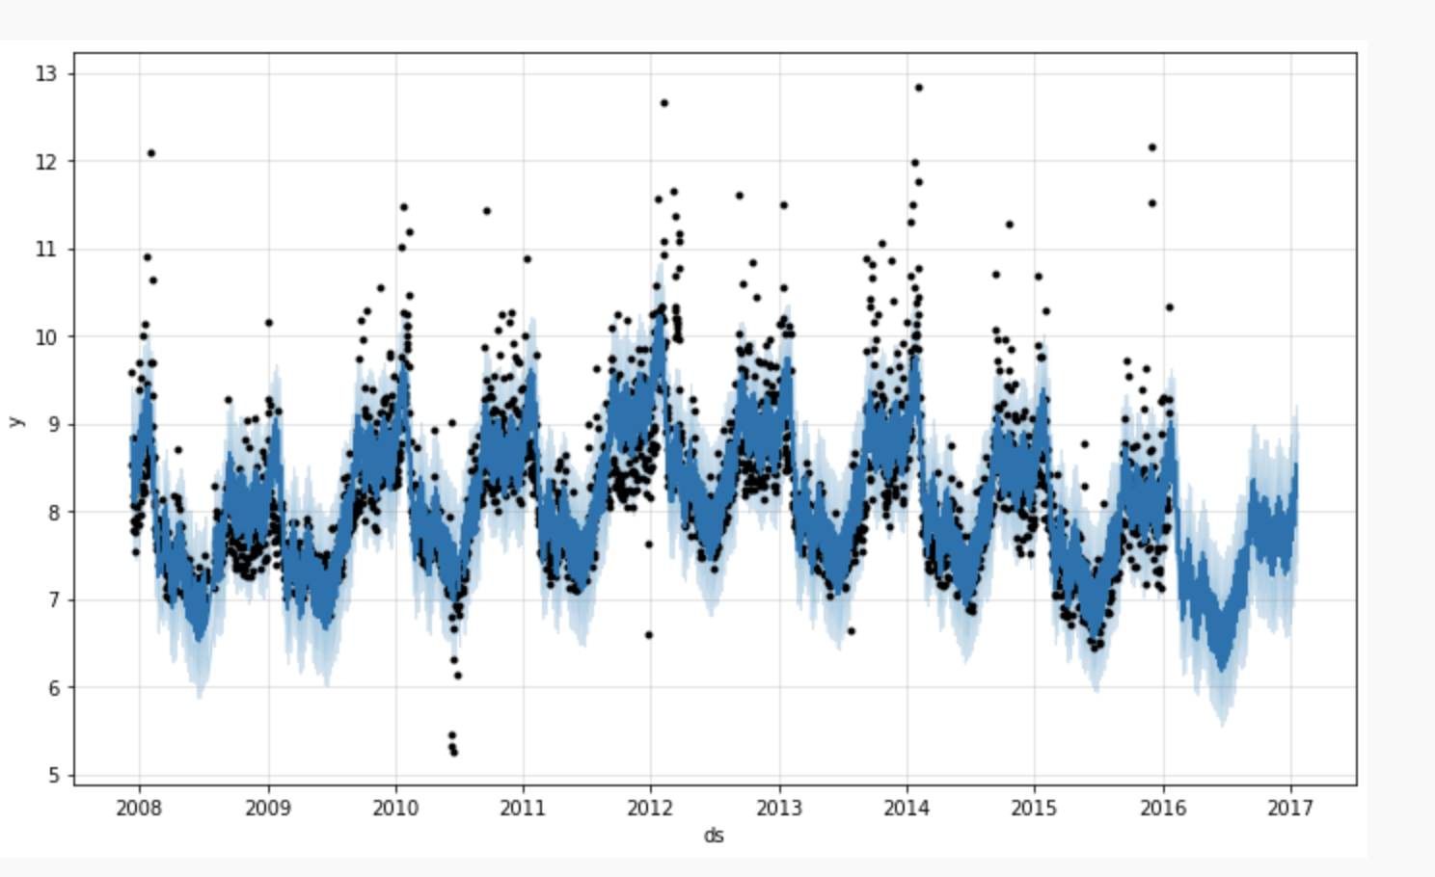
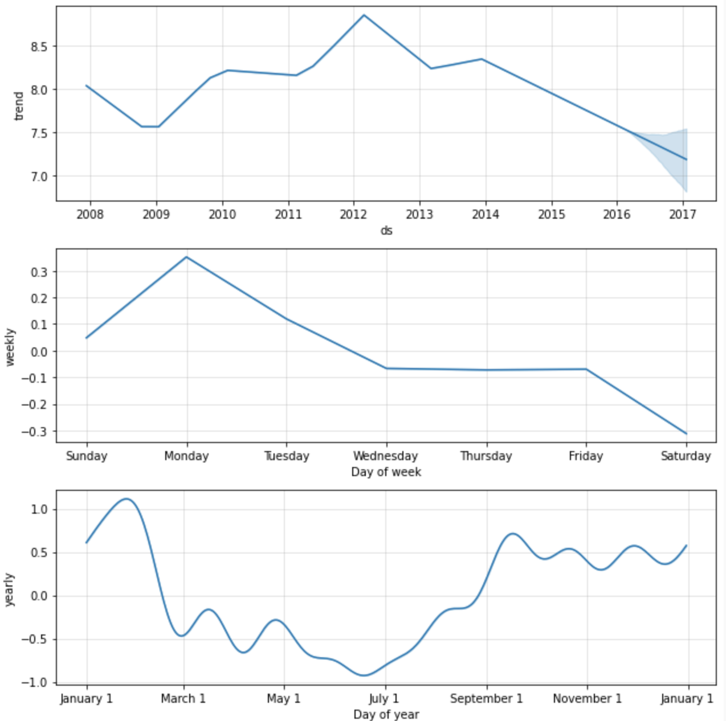
PREDICTION WITH PROPHET
SOLUTION: FRAMEWORK I
The application of prophet is direct with its Python library. The installation is simple and the operation is similar to the sklearn library
We create an instance of Prophet The data frame that we will use has to have two main columns
ds (datestamp): Ideally with YYYY-MM-DD for a date or YYYY-MM-DD HH:MM:SS for a timestamp.
y : Value to predict, which has to be numerical
Fit the model using the dataframe
We develop the predictions
We evaluate the result of the model Validate error metrics
Visualize the overall result
Visualize the components
Notes:
https://www.kaggle.com/prashant111/tutorial-time-series-forecasting-with-prophet

Slide 54
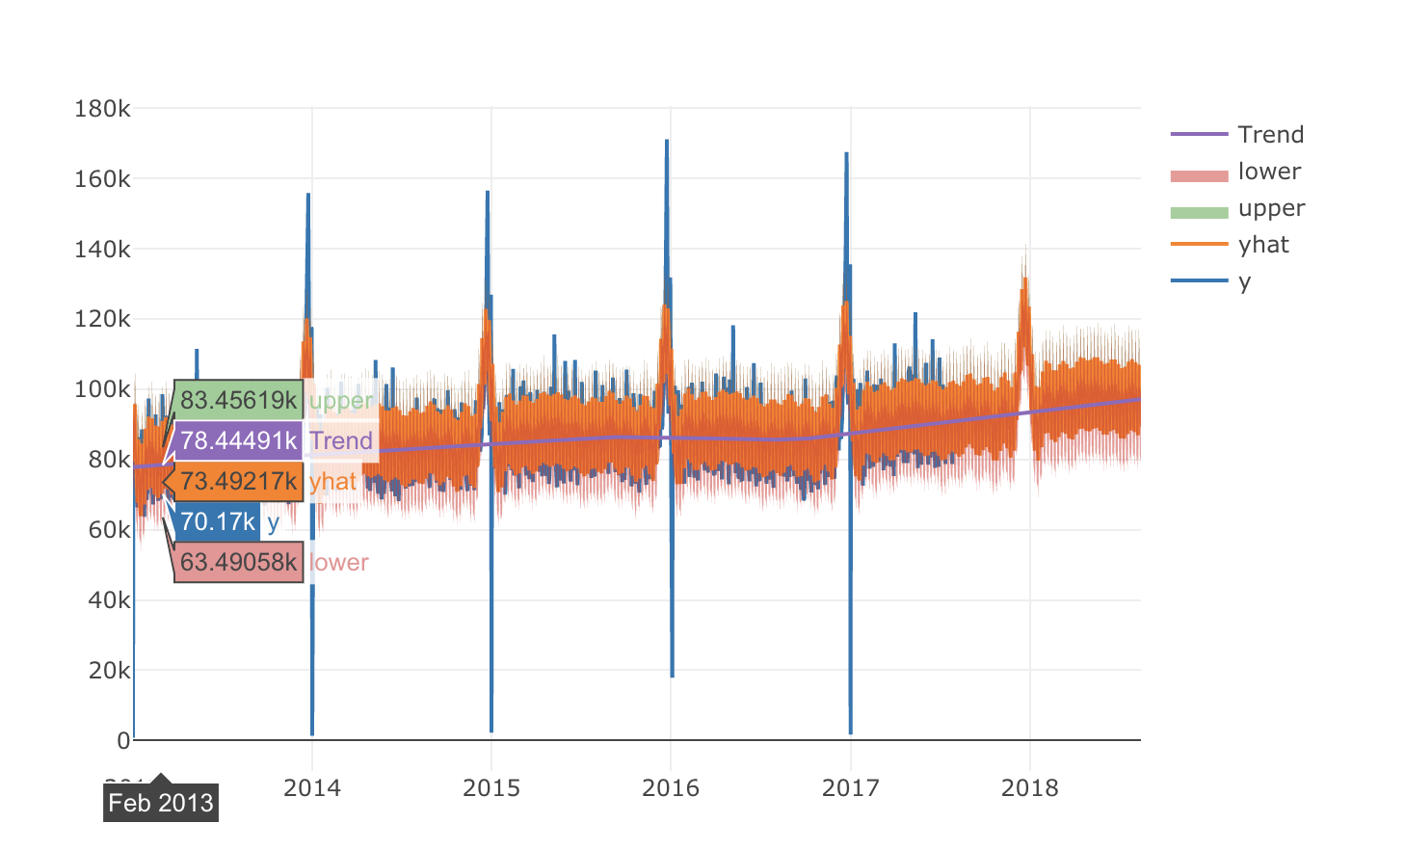
PREDICTION WITH PROPHET
SOLUTION: FRAMEWORK II
Once we have developed the simplest version, Prophet offers flexibility to continue iterating and to improve the results of the model:
Cross-validation: Vary the horizon, the initial period to obtain the different results of the model.
Modify seasonality: Seasonality can be adapted to detect different patterns, or influence information about the fourier transform
Trend adjustment
Include Holidays As we have already seen, holidays can have a big impact on time series
Include other variables
Notes:
https://www.kaggle.com/prashant111/tutorial-time-series-forecasting-with-prophet
https://www.kaggle.com/armamut/predicting-transactions-fb-prophet-tutorial
https://ichi.pro/es/pronostico-de-ventas-con-prophet-de-facebook-274525754552726

Slide 55
MACHINE LEARNING FOR TIME SERIES
05

Slide 56
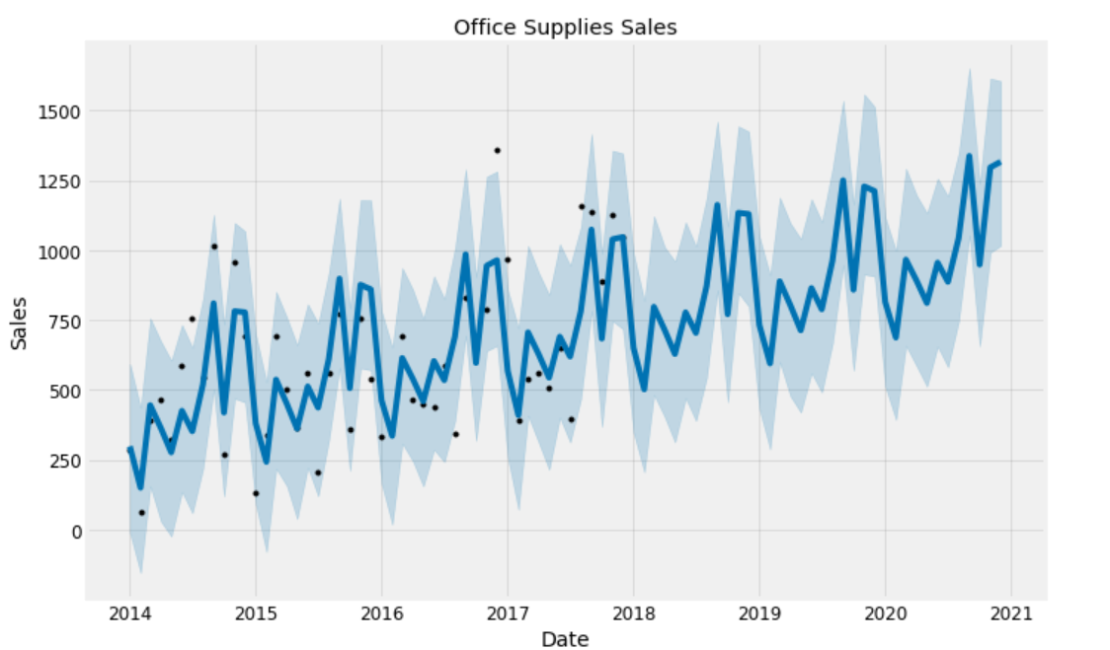
TIME SERIES WITH ML
ML FOR TS: INTRODUCTION
Currently, machine learning algorithms are very popular for multivariate time series analysis. We will focus on boosting models for regression cases. These are efficient algorithms that allow us to target a number that depends on inputs, in which we can include the encoded temporal information, and multiple exogenous variables.
However, there are many dilemmas:
Which alternative offers better results?
In which cases is it better to use Boosting models?
How do you capture long-term trends?
How to enter the time variables in the model? And which ones?
What history to use to train our model?
How to manage uncertainty?
How to handle time constraints?
Black Box: What interpretability can we get out of the models?
We will focus on temporal issues.

Slide 57
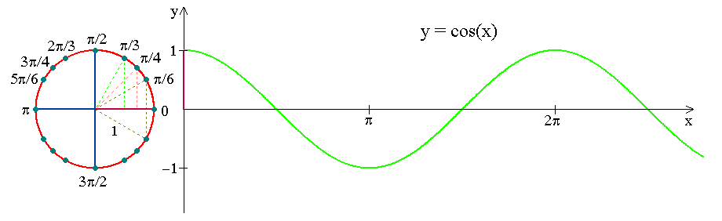
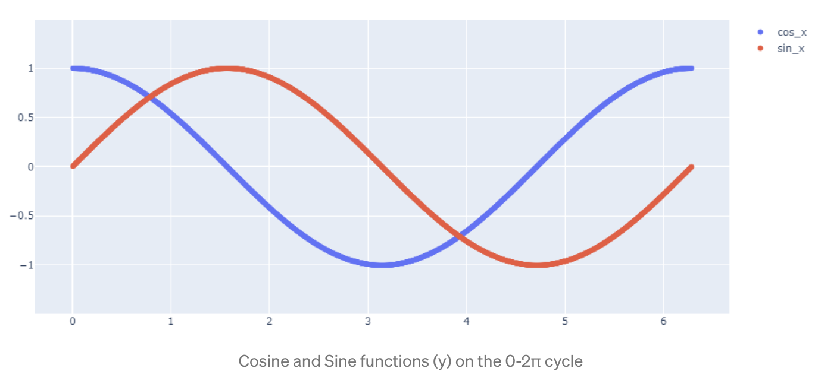
TIME SERIES WITH ML
CAT BOOST: TEMPORAL INFORMATION
As a general rule, Machine Learning models do not support the date format, so we will have to adapt our information to the inputs accepted by these models.
Creating direct variables: As we saw, we can directly include integer type variables.
Creating indirect variables: Including other types of information such as vacation, or day or night time can be very useful. Also combine with other variables which have business sense. Past values or coefficients to include trends.
Encoding of cyclic variables : A characteristic of temporal variables is that they are cyclical, and nonlinear. The time 23:30 and 00:30 are only separated by one hour.

Slide 58
TIME SERIES WITH ML
BOOSTING: FUTURE INFORMATION
Ç
Another aspect that is key is to use only data that is available at the time of prediction. The phenomenon of using unavailable data is called data leakage, and it offers results that are too optimistic too good to be true, in training that can never be achieved in testing. This can occur in multiple ways.
Use real data and not predictions
Data that is not yet available at the moment
Use dynamic variables without change logs
Techniques to reduce it:
Perform data preparation within your cross-validation folds.
Retain a validation dataset for final sanity verification of your developed models.

Slide 59
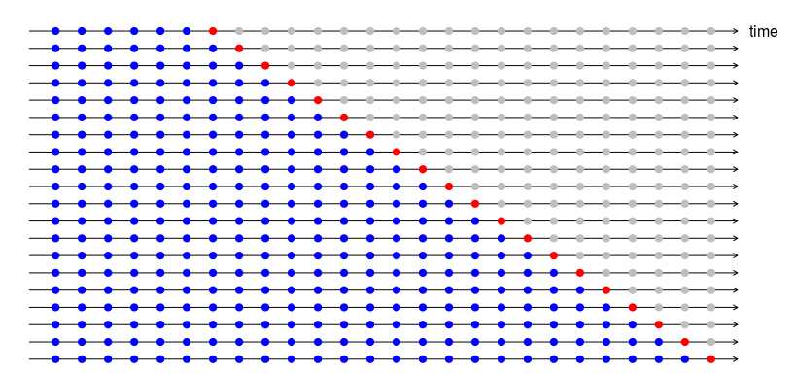
TIME SERIES WITH ML
BOOSTING FOR TS: CROSS-VALIDATION
The observations are not independent, and it is necessary to take this into account for our models. For time series, it’s normal is to opt for the out-of-sample modeling, to separate the train and test, so that the model can follow the chronological order of prediction. In practice it is how they are going to be applied, and allows us that the model do not know:
Cross-Validation: Separate the train and test data to have an approximation of the real result, and avoid overfitting.
Select a granularity suitable for our model Selection of data history for train. Not always more data implies better results. Select a history with business knowledge and go testing
Special Periods (COVID): How to deal with special events, does it make sense to include them in our models? It is difficult to know a priori. Another option is to include dummies variables that contain information about the event

Slide 60
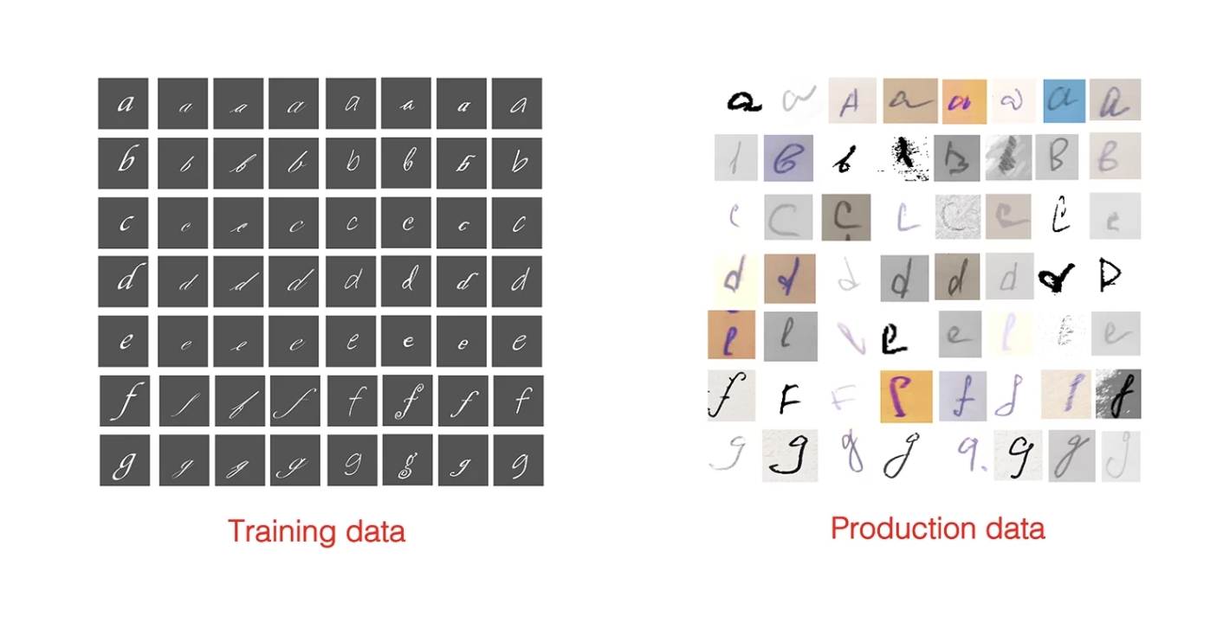

TIME SERIES WITH ML
BOOSTING FOR TS: TEMPORAL DETOUR
Situations and context change over time, and consequently, the target behavior of ML models as well. This change can be: gradual, cyclical or suddenly.
This becomes especially important when predicting time series. Our model projects information from the past, into the future. As we saw before, train and test data refer to different moments of time, which may not have the same characteristics.
In conclusion: the drift will determine the performance of our model. There is no simple solution, but there are ways to detect and combat it:
Retrain models on a regular basis
Drift detection test: Some libraries, such as adrift, make it easier for us to detect drift
Understand the possible drift, its causes and its implications Modifications or new model: include new variables that may be important in the new context
Notes:
https://evidentlyai.com/blog/machine-learning-monitoring-data-and-concept-drift

Slide 61


TIME SERIES WITH ML
BOOSTING FOR TS: INTERPRETABILITY OF TIME
In the past, one of the main objections to ML models was their lack of explainability, as they were considered black box models. In fact, there was some trade off between the accuracy and interpretability of the models.
Today, it has evolved in that aspect and you can better understand the operation of ML models, the results they offer and how the input variables relate to each other. In the case of time series, it has great importance since it allows us to understand the impact of terms
Classical interpretation
Shap Values
Dashboards for Automatic Explanations

Slide 62
TIME SERIES WITH ML
BOOSTING PS: DISCLAIMER!!
Estudiar estas series es muy útil para familiarizarse con muchos conceptos (lags, serias auto
Although boosting models are very popular for time series prediction for their efficiency, easy usability and performance, certain aspects must be taken into account for their application.
The main one is that they do not capture trends towards the future (e.g. a straight line). Boosting models capture trends from the past and represent them in the future, but they do not correctly predict the values of the inputs that are not in the inputs in the training phase.
Therefore, boosting models are very efficient when looking for a relatively close value, and lose meaning at the moment when long-term trends begin to be important. This contrasts with parametric regressors (such as linear regression), which actually look for the best parameters of a hyperplane (straight line if any) to fit their data. Linear regression looks at data as a straight line with a certain slope (and an interception).
There are methods that allow us to calculate that. You can change the base learner of your XG Boost model to a GLM (generalized linear model) by adding "booster": "gblinear" to the parameters of your model.

Slide 63

Thanks!

